Slide 1
Lecture 1: Motivation and basic concepts of large model training

Slide 2
Course Agenda
08:50 | — | 09:00 |  | Welcome
09:00 | — | 10:00 |  | Lecture 1: Motivation and basic concepts
10:00 | — | 11:00 |  | Lab 1/Part 1: From SLURM basics to GPT model pretraining
11:00 | — | 11:15 |  | Break
11:15 | — | 12:15 |  | Lecture 2: Advanced concepts of large model training
12:15 | — | 13:15 |  | Lab 1/Part 2: Multi-node scaling
13:15 | — | 14:00 |  | Lunch break
14:00 | — | 15:00 |  | Lecture 3: Large model deployment
15:00 | — | 16:00 |  | Lab 2: Hands on example of how to deploy LLama2 into Triton Inference Server
16:00 | — | 17:00 |  | Assessment support

Slide 3
Part 1
Motivation and basic concepts
Lecture
Why large models?
Impact on AI landscape
Challenges of large model training
Basic techniques for memory reduction
Overview of the tools used in the lab
Lab 1 / Part 1
Introduction to the SLURM class environment
GPT model pretraining
Multi-node scaling
Optimize the GPT model pretraining
https://www.nvidia.com/en-gb/data-center/dgx-systems/
Notes:
To put it in perspective

Slide 4
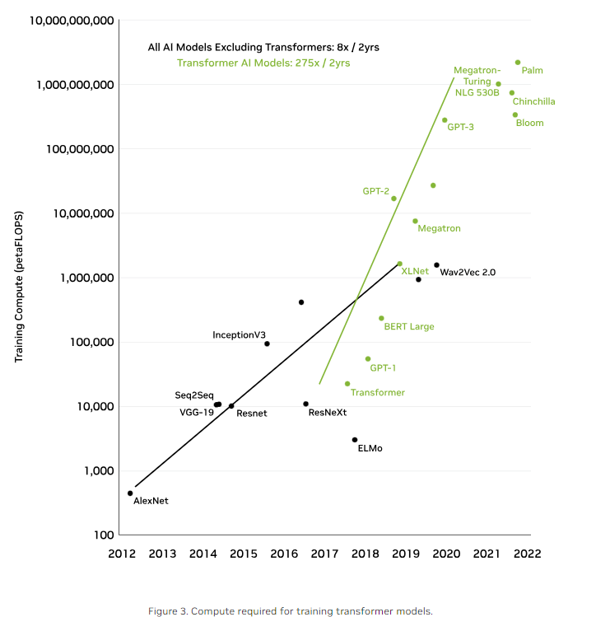
Dramatic increase in Model Sizes
The Trend Continues
2017 paper – Attention is All you Need introduced the transformer architecture
Removed the sequential processing dependency of RNNs
Enabled language models to be trained with parallelism
Beginning of the Large Model Revolution
BERT from Google in 2019
Trained on large corpus of text data and applied embeddings to other tasks
Popularized finetuning of models to get task specific embeddings
Megatron-LM (NVIDIA) 2021 – showed how to scale training efficiently to thousands of GPUs with model parallelism which led to the explosion of larger models
GPT-3 was the precursor to the popular chat-gpt which made LLMs commercially viable
Notes:
Large models continue to grow.
This chart shows training compute in PetaFlops which is 10^15 Floating point operations
The black line shows different models that were not based on the transformer architecture as you can see the max parameters they went up to was about 1 million
For transformer models on the green line this is not the case. There is a significant increase in the number of parameters and hence the training flops needed

Slide 5
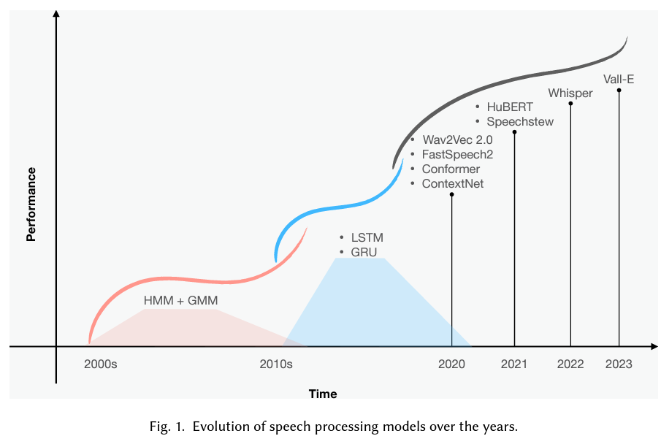
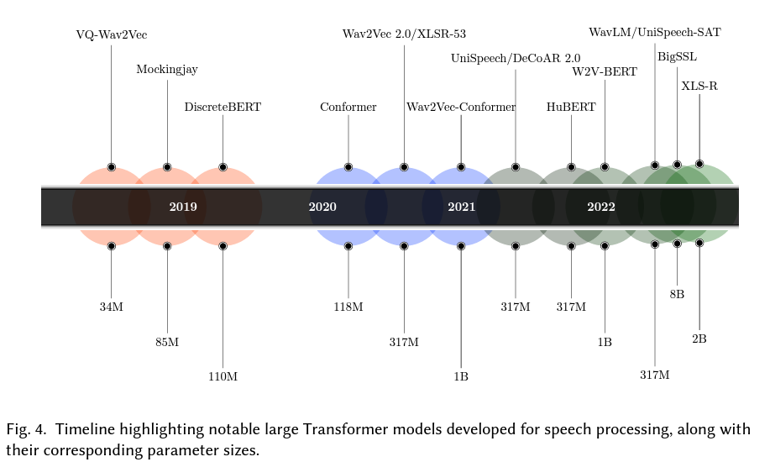
Transforming speech processing
Speech processing accuracy has improved significantly over time
Increase in performance of model tracks with increase in model size
From A Review of Deep Learning Techniques for Speech Processing, 2023
Notes:
The Large Model revolution is also affecting different domains
Here we see speech processing
On the ledge we have all the notable models and techniques that have advanced the field over time
ON the right we see the sizes of these models. Not as large as llms but still effective
Whisper is 1.5B

Slide 6
Reasons of success of Large neural networks

Slide 7
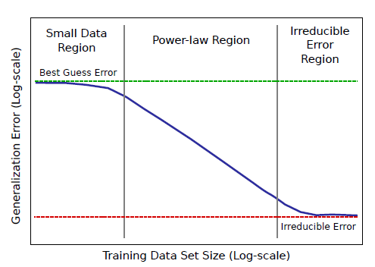
The cost of Labels
Limits the utility of supervised deep learning models
Exponential increase
To reduce generalization error, significant amounts of costly labelled training data is needed
Hestness, J., Narang, S., Ardalani, N., Diamos, G., Jun, H., Kianinejad, H., ... & Zhou, Y. (2017). Deep Learning Scaling is Predictable, Empirically. arXiv:1712.00409.
Notes:
It all boils down to the cost to generate these high-quality labels.
Notice that the x and y axis are in logarithmic scale, this means the size of training data needed for large neural networks exponentially increases with your desired error rate
In order to generate high-quality data at the scale required by large neural networks, the cost would be too high

Slide 8
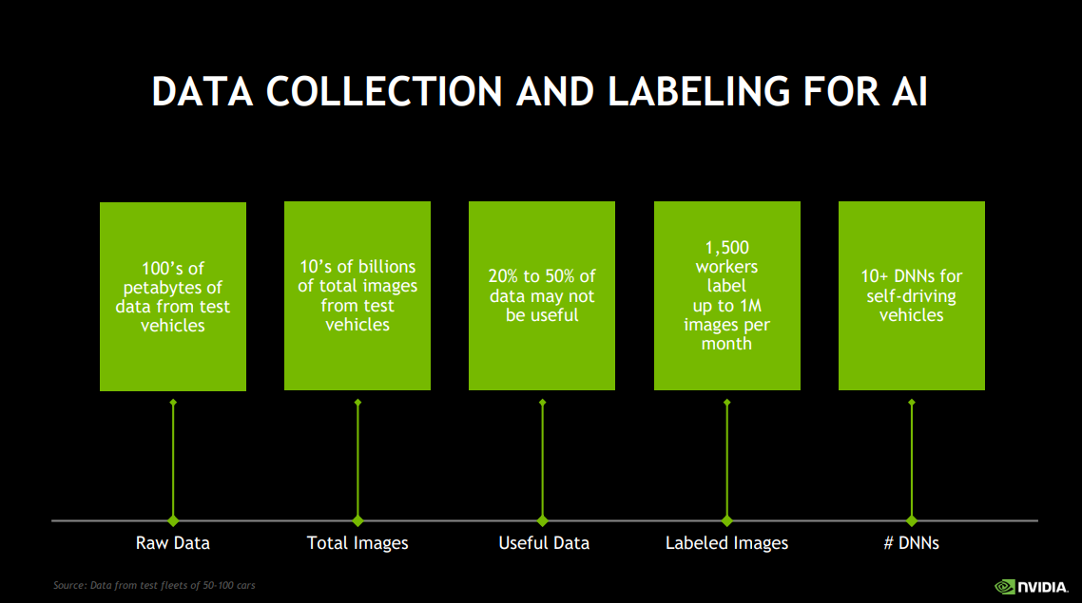
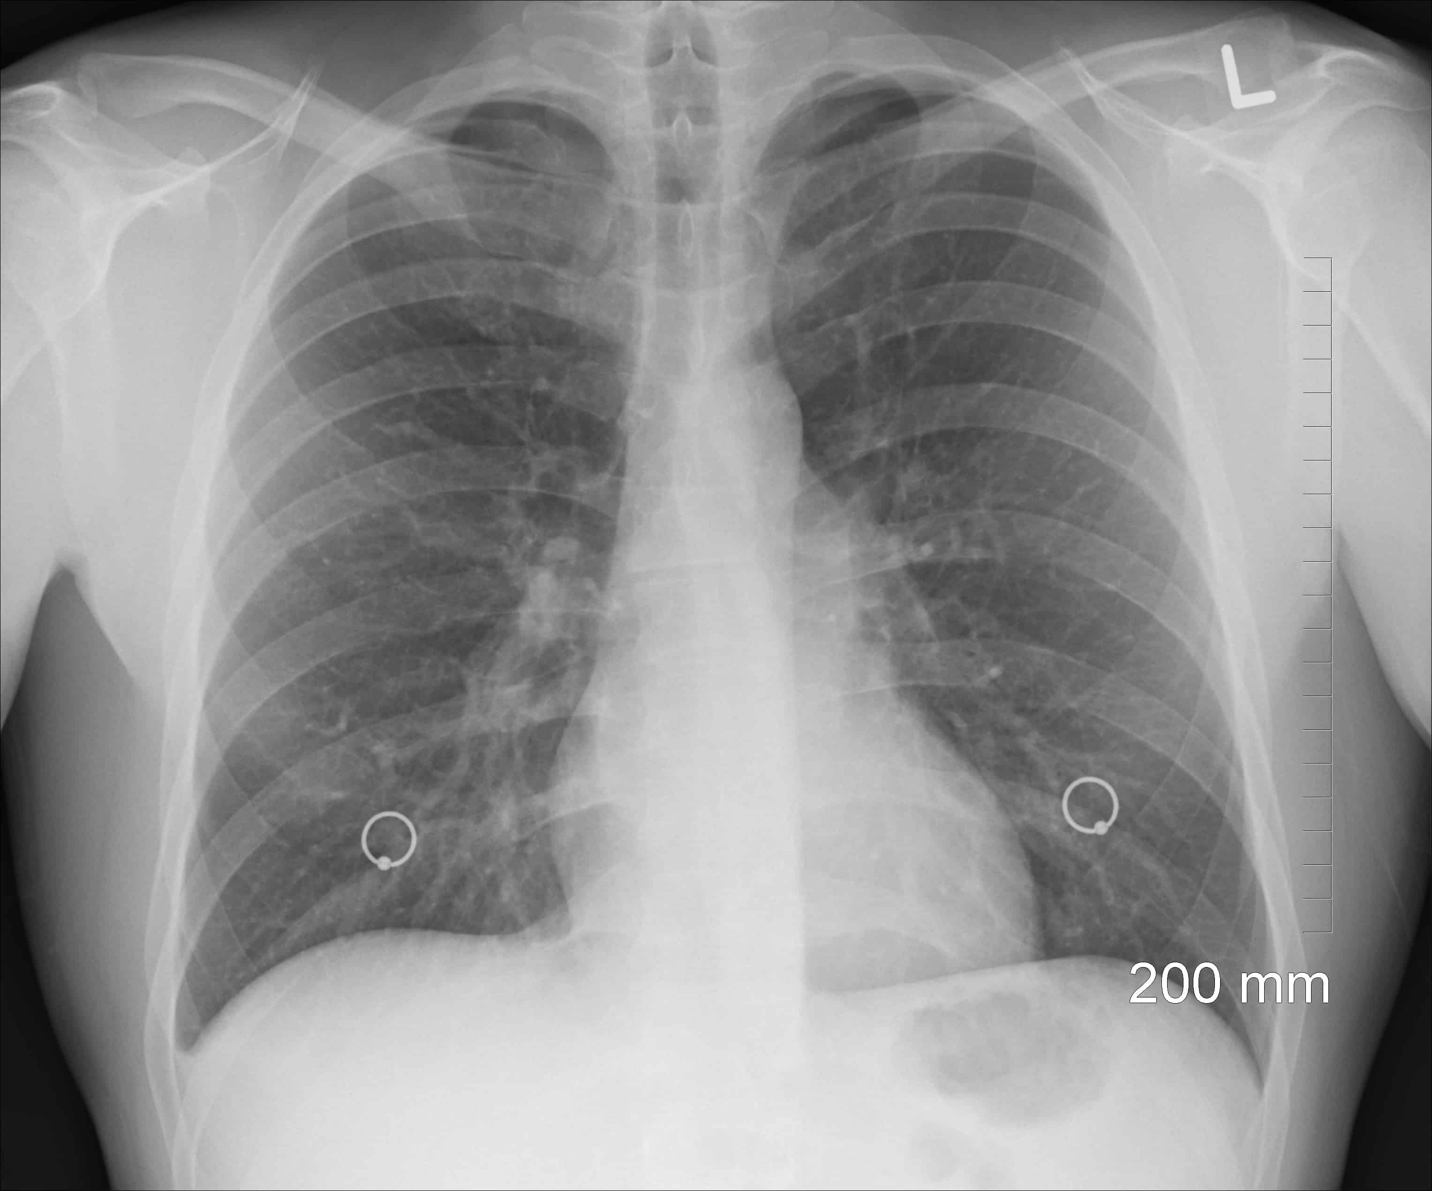
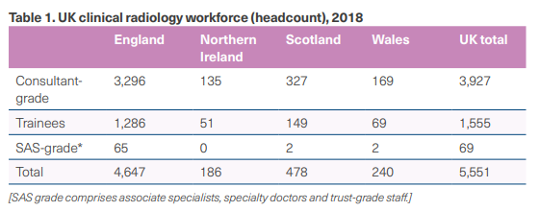
The cost of Labels
Hard limits to supervised deep learning utility
Self-Driving Auto Example
Clinical Radiology Example
Labelling medical image data requires highly skilled radiologists
Thousands of human data labellers are needed to create effective training data
Not enough available skilled people to label training data, only 3296 radiologists in England
Notes:
Labeling is time consuming. Here we show two examples of labels needed for different talks.
On the left, for self driving cars, you start with 10’s of petabytes of data collected from cars and then use 1500 people to label 1Million images/month
On the right hand side, we show that for tasks that require significant expertise the number of qualified data labelers decreases significantly.
There are only about 3k ish radiologists in England so to label petabytes of data might not be economically feasible to hire half of them to label that data
This expertise requirement makes some problems more difficult to solve
So what other options do we have?

Slide 9
Self-supervised learning

Slide 10

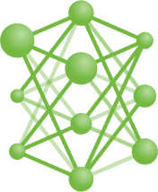





Self and un-Supervised Learning
What to do in the absence of labels
?
Is there a way to use publicly available (unlabelled) text data to train a large language model to do next token prediction?
Notes:
The question was what can we do with the vast amount of data we have on the web

Slide 11

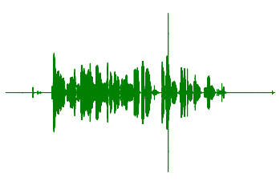
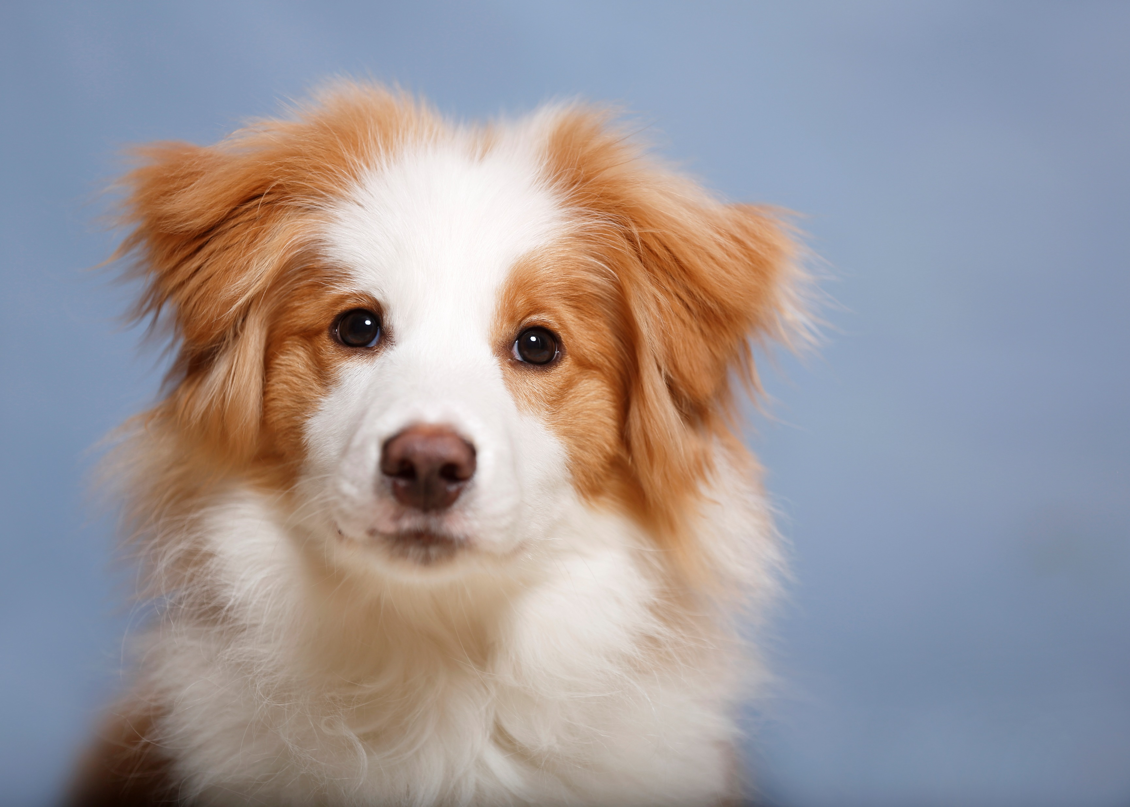
Self and un-Supervised Learning
What to do in the absence of labels
Masking Loss
Contrastive Loss
Omit data and force the model to predict what missing data was
Use out of distribution data to condition model on in-distribution data
The cat is playing in the garden
garden
Not same picture
Masking loss applied to text prediction
Masking loss applied to Speech Processing
Notes:
There are two ways to to generate data in the absence of labels.
The first is with a masking loss, essentially hiding data from the model and then asking the model to predict what the hidden data was
On the right you have a contrastive loss which trains on very out of distribution data vs in-distribution data to create a kind of labelled dataset.

Slide 12
The Scaling Laws

Slide 13
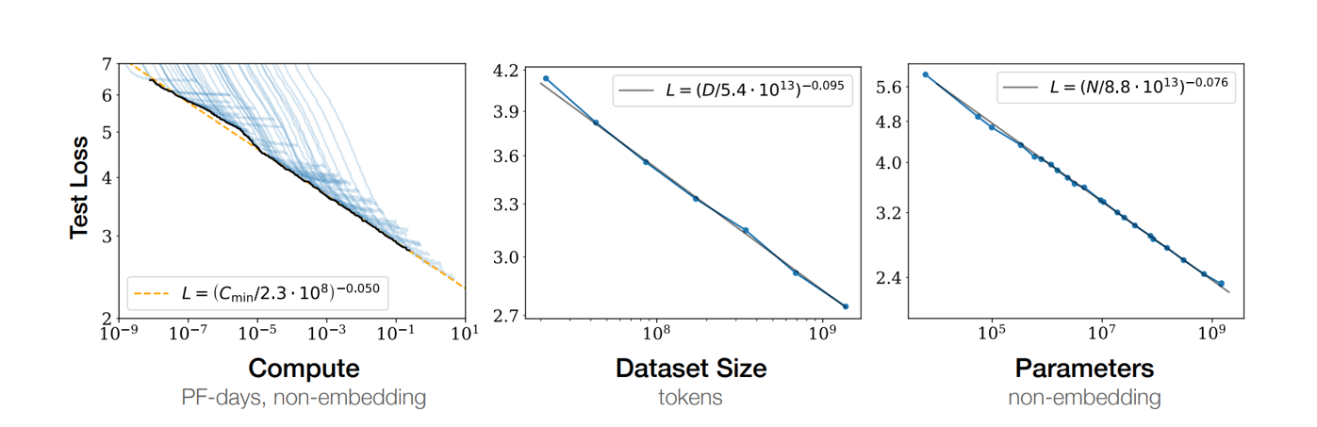
Empirical evidence
The Scaling Laws in NLP
Error rate decreases with a simultaneous increase in compute, dataset size and model size
Tom Henighan, Jared Kaplan, Mor Katz, Mark Chen, Christopher Hesse, Jacob Jackson, Heewoo Jun, Tom B. Brown, Prafulla Dhariwal, Scott Gray, Chris Hallacy, Benjamin Mann, Alec Radford, Aditya Ramesh, Nick Ryder, Daniel M. Ziegler, John Schulman, Dario Amodei, Sam McCandlish. Scaling Laws for Autoregressive Generative Modeling.2020
Notes:
From the field on Natural Language Processing we identified these scaling laws of large neural networks that says when you increase the compute, size of the network and the data, correspondingly, you see an increase performance of your NN.
Each of the charts on the bottom shows experiments where the compute, size of network and size of training data were increased and the respective decreases in error rate

Slide 14
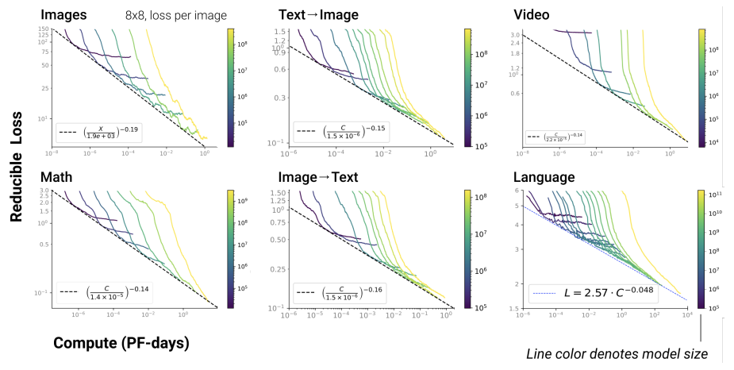
Empirical evidence
The Scaling Laws for generative models
Error rate decreases with a simultaneous increase in compute, dataset size and model size
Henighan, Tom, et al. "Scaling laws for autoregressive generative modeling." arXiv preprint arXiv:2010.14701 (2020).
Notes:
And here is another excerpt from a more generalized paper that looks at how these scaling laws apply across many more domains such as video, image-to-text, text-to-image etc.

Slide 15
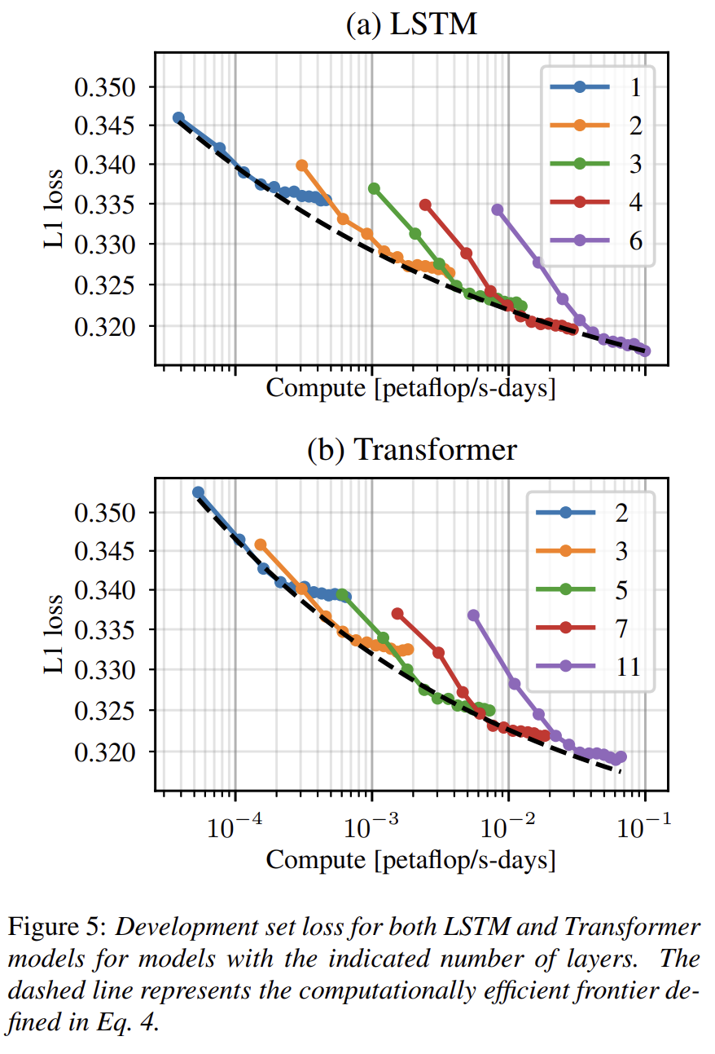
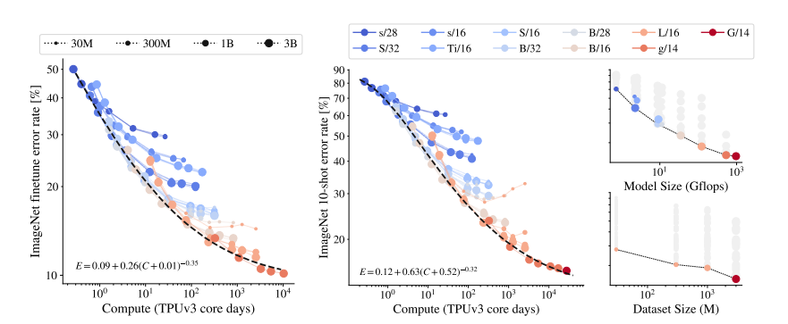
Empirical evidence
The Scaling Laws in Computer Vision & Speech
Error rate decreases with a simultaneous increase in compute, dataset size and model size
Zhai, Xiaohua, et al. "Scaling vision transformers." arXiv preprint arXiv:2106.04560 (2021).
Droppo, Jasha, and Oguz Elibol. "Scaling Laws for Acoustic Models." arXiv preprint arXiv:2106.09488 (2021).
Notes:
Even across domains such as computer vision we see the same phenomena apply
Here on the bottom your are seeing the a decreased error rate proportional to the increase in compute on the ImageNet dataset

Slide 16
The cost
Notes:
To put it in perspective

Slide 17
Are Large language models worth it?
The cost of incremental improvement
Plots shows test set loss on y-axis and increasing compute scale on the x-axis
As compute grows you get a decrease in test loss error
The reduction in test loss error is not directly proportional to the increase in compute
Why are AI companies interested in using large compute if accuracy doesn’t improve that much?
10,000x Increase
Tom Henighan, Jared Kaplan, Mor Katz, Mark Chen, Christopher Hesse, Jacob Jackson, Heewoo Jun, Tom B. Brown, Prafulla Dhariwal, Scott Gray, Chris Hallacy, Benjamin Mann, Alec Radford, Aditya Ramesh, Nick Ryder, Daniel M. Ziegler, John Schulman, Dario Amodei, Sam McCandlish. Scaling Laws for Autoregressive Generative Modeling.2020
Notes:
As shown on this slide, a 10,000x increase in computational power is not trivial so this is something to seriously consider for the ROI on your error rates

Slide 18
Beyond accuracy
Notes:
To put it in perspective

Slide 19
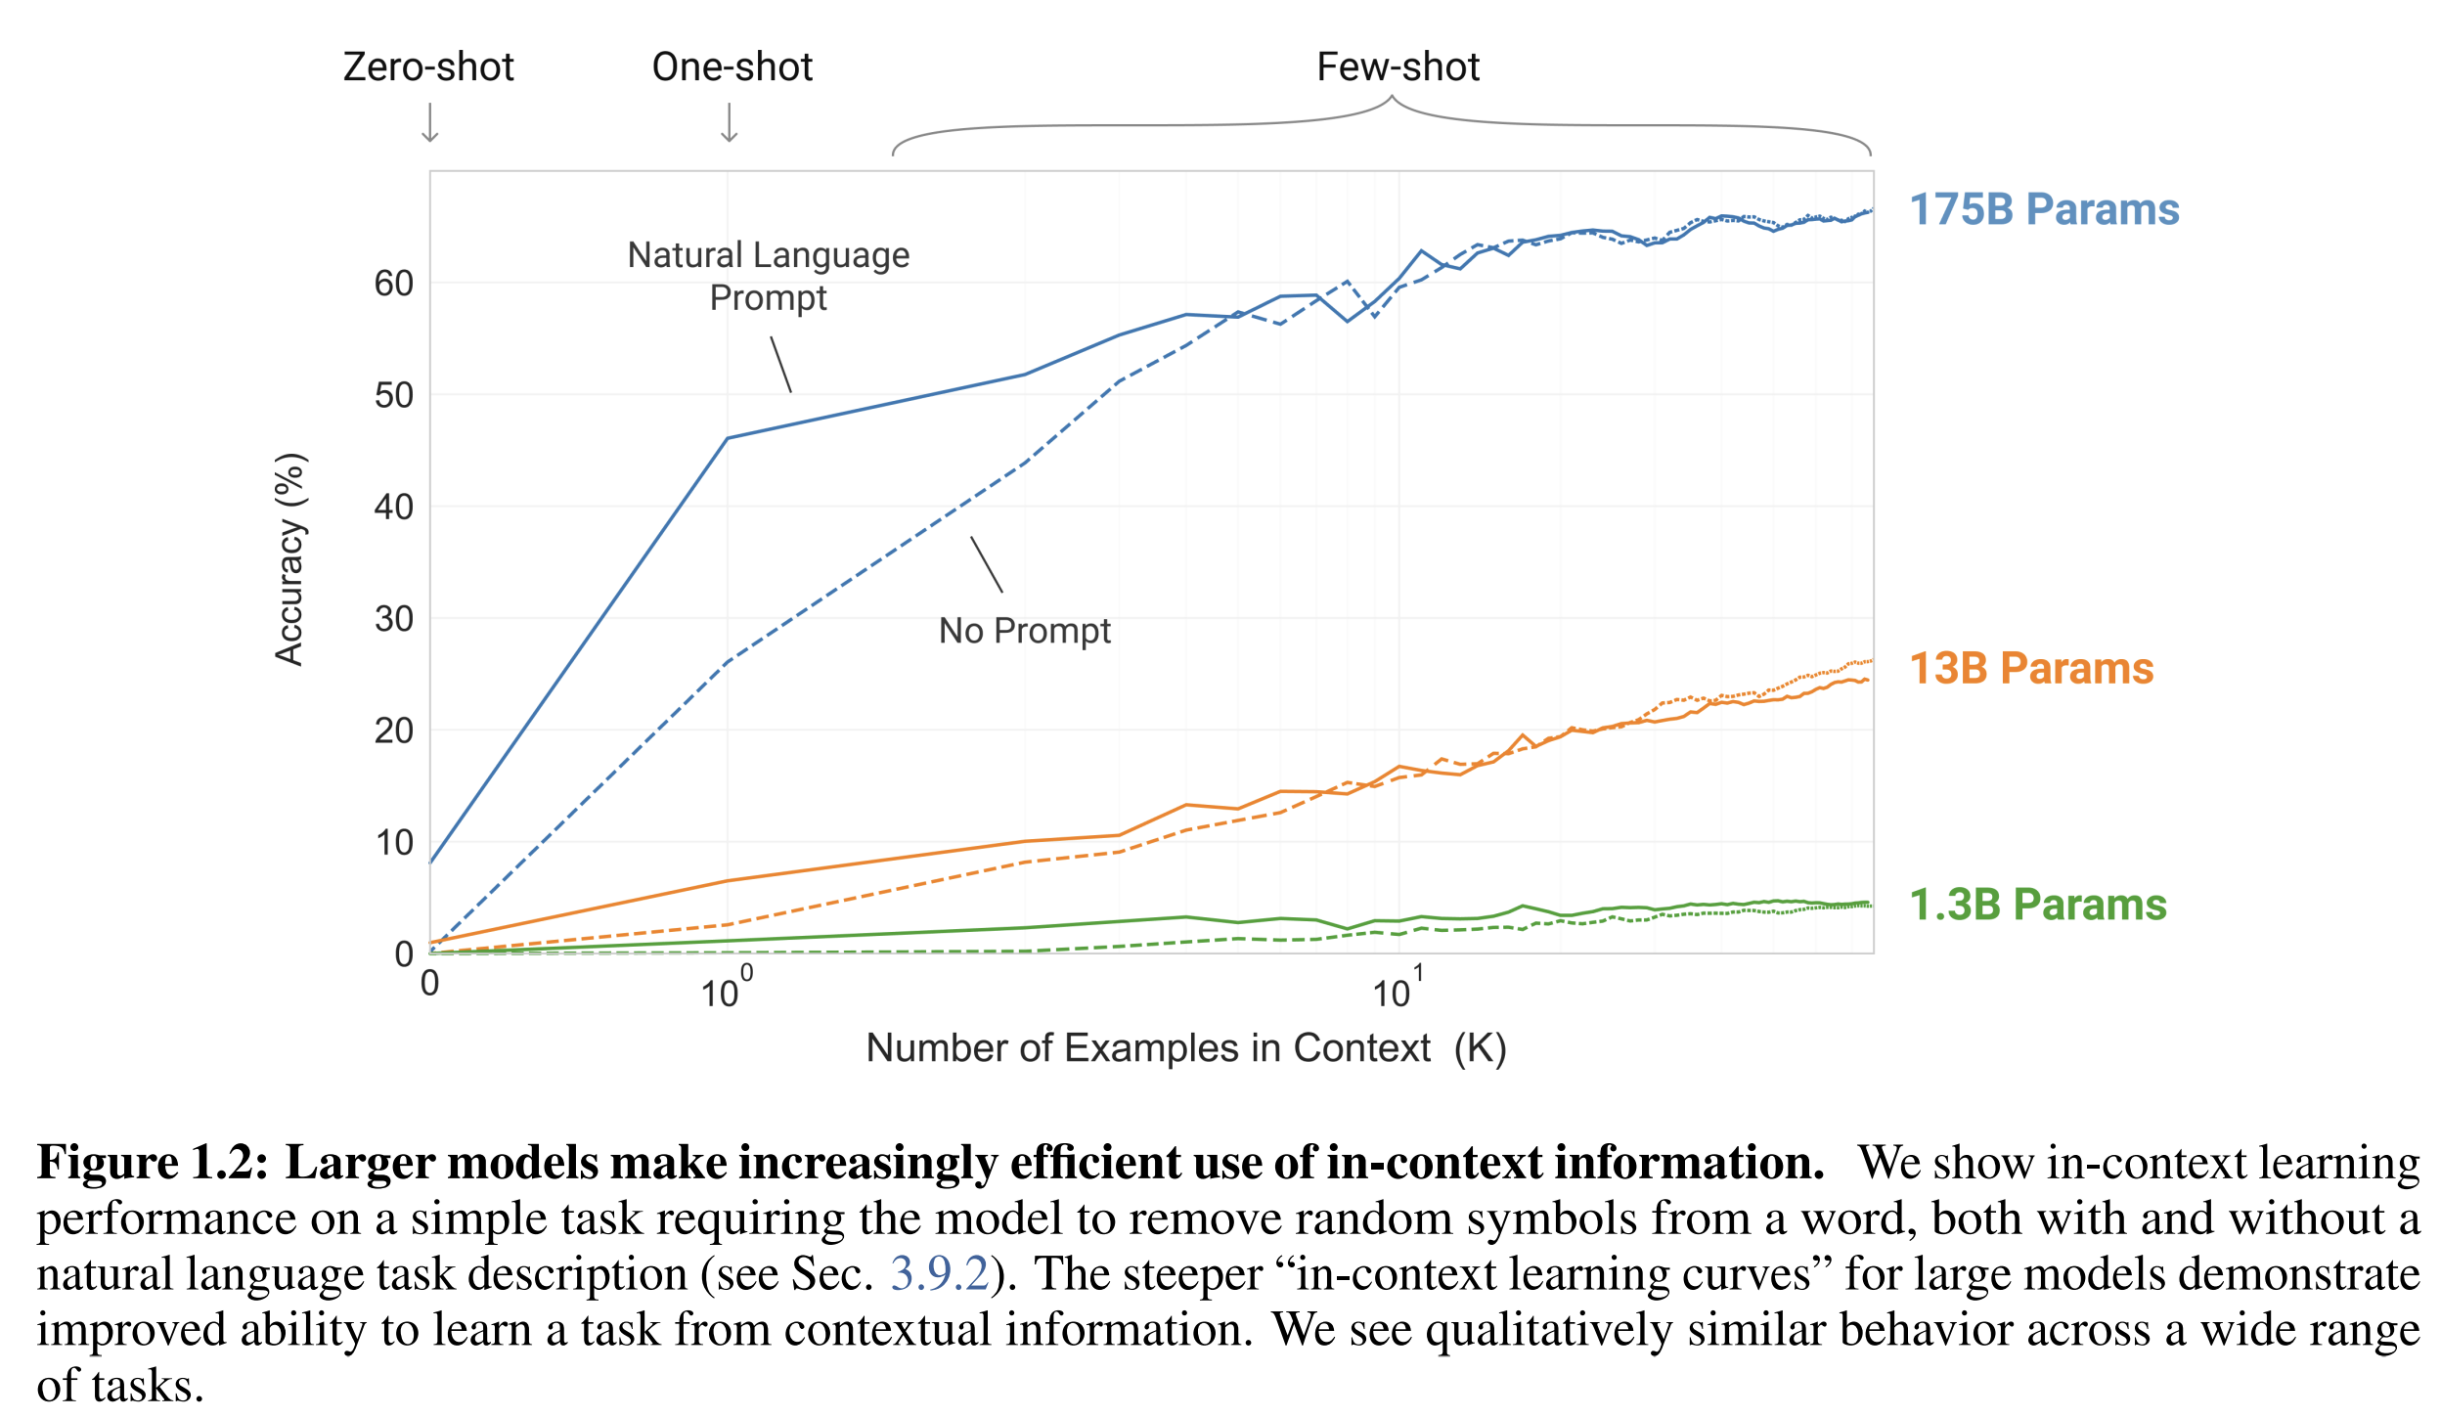
Few shot learning
Learning from far fewer examples
Large models are more sample efficient needing less epochs to train and fewer examples learn new tasks
Brown, T. B., Mann, B., Ryder, N., Subbiah, M., Kaplan, J., Dhariwal, P., ... & Agarwal, S. (2020). Language models are few-shot learners. arXiv preprint arXiv:2005.14165..
Notes:
This chart shows the amount of training data on the x-axis vs the accuracy on the y-axis.
The curves represent similar model architectures of increasing model size.
You have three different model sizes: 1.3B, 13B and 175B
The x-axis shows the number of training examples used to finetune, ranging from a single example to 10 samples, to 100
The smaller models shown in green and orange are not able to learn as well as a large model, meaning, getting higher accuracies with more training data
But on the blue curve, even with a single example, the very large model is able to learn the task much faster than the smaller models, even though the smaller models were exposed to much more examples.
As the networks get bigger, they essentially learn faster
This is the reason why the scaling laws and large neural networks are soo exciting.

Slide 20
Example of Few Shot learning (Prompt Design)

Slide 21
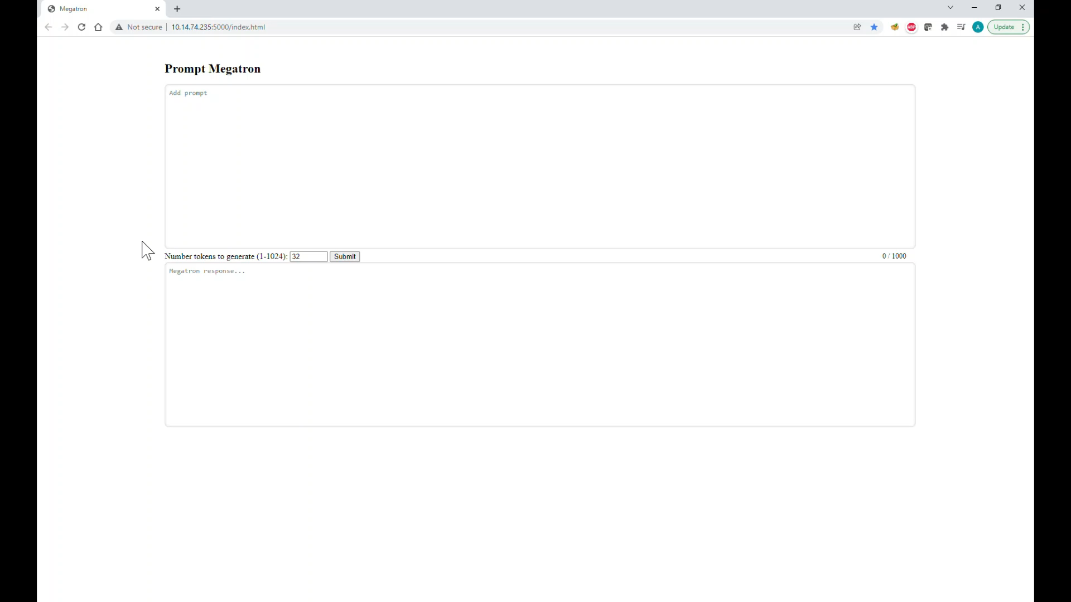
Notes:
To put it in perspective

Slide 22
Multitask skills
Notes:
To put it in perspective

Slide 23
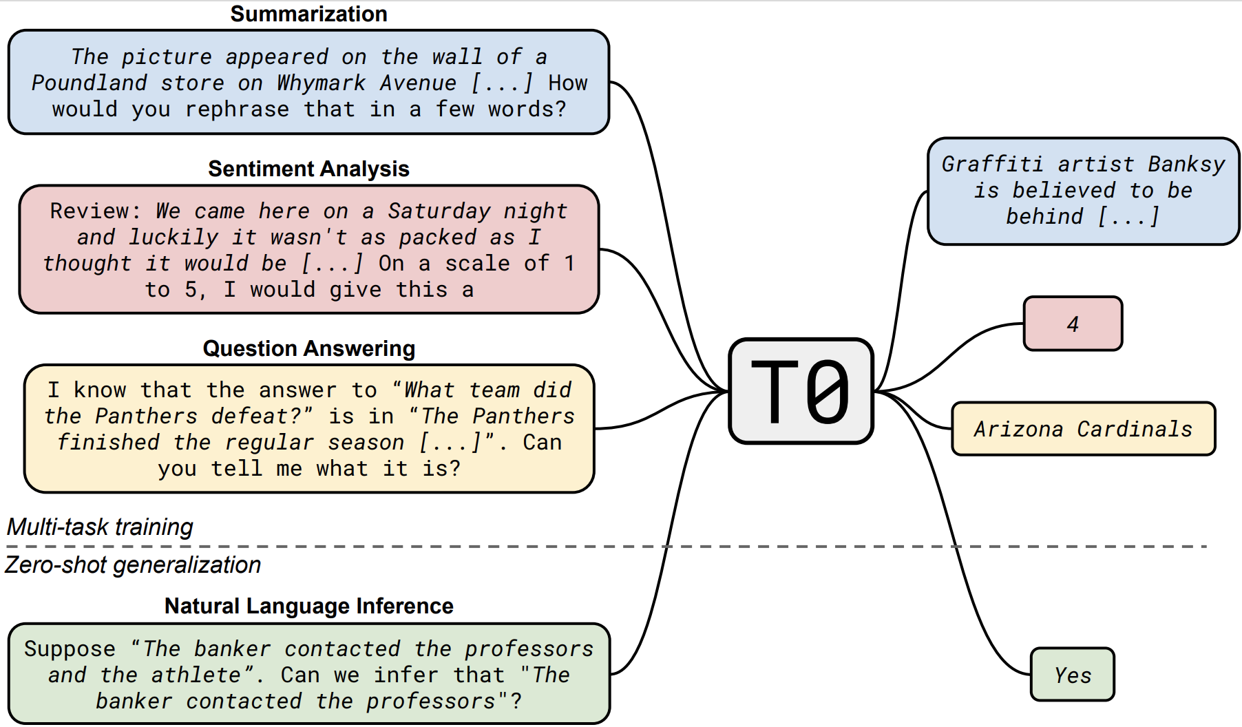
Multitask skills
Generalize to unseen Tasks: T0
Can you enable better model generalization by training with multiple tasks vs large datasets
Tasks were specified in natural language prompts curated by volunteers
Multiple prompts per dataset were captured to improve word choice robustness of prompts
Trained a T5 model on a subset of tasks and evaluated on tasks not trained on.
Model was 16x smaller than GPT-3 and exceeded 9/11 hold out sets for performance
Multitask Prompted Training Enables Zero-Shot Task Generalization
Victor Sanh, Albert Webson, Colin Raffel, Stephen H. Bach, Lintang Sutawika, Zaid Alyafeai, Antoine Chaffin, Arnaud Stiegler, Teven Le Scao, Arun Raja, Manan Dey, M Saiful Bari, Canwen Xu, Urmish Thakker, Shanya Sharma Sharma, Eliza Szczechla, Taewoon Kim, Gunjan Chhablani, Nihal Nayak, Debajyoti Datta, Jonathan Chang, Mike Tian-Jian Jiang, Han Wang, Matteo Manica, Sheng Shen, Zheng Xin Yong, Harshit Pandey, Rachel Bawden, Thomas Wang, Trishala Neeraj, Jos Rozen, Abheesht Sharma, Andrea Santilli, Thibault Fevry, Jason Alan Fries, Ryan Teehan, Tali Bers, Stella Biderman, Leo Gao, Thomas Wolf, Alexander M. Rush
Notes:
One of the benefits of the larger models is that you can have a single model performing well across different tasks.
This is the T5 paper from google. The goal is to get great zero-shot generalization.

Slide 24
Part 1
Motivation and basic concepts
Lecture
Why large models?
Impact on AI landscape
Challenges of large model training
Basic techniques for memory reduction
Overview of the tools used in the lab
Lab 1 /Part 1
Introduction to the SLURM class environment
GPT model pretraining
Multi-node scaling
Optimize the GPT model pretraining
Notes:
To put it in perspective

Slide 25


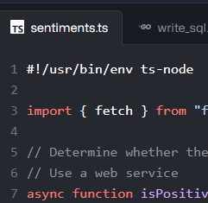

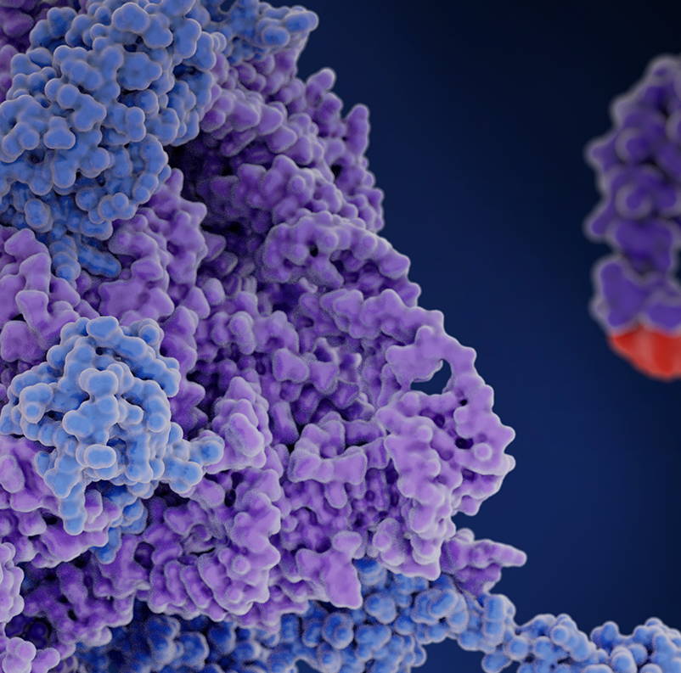
Generative AI is Transforming Business
TEXT GENERATION
TRANSLATION
CODING
VISUAL CONTENT
LIFE SCIENCE
Summarization
Translating Wikipedia
Dynamic Code Commenting
Brand Creation
Molecular Representations
GPT-4
Marketing Copy
NLLB-200
Real-Time
Translation
CODEX
Function Generation
e-Diffi
Gaming Characters
MegaMolBART
Drug Discovery
Enterprises that adopt next-generation AI like LLMs and Generative AI are 2.6X more likely to increase revenue by 10% or more but must invest in their AI infrastructure to fully reap the benefits.
-Accenture Research. Breakthrough Innovation: Is your organization equipped for breakthrough innovation? WEF 2023.
Notes:
Generative AI is revolutionizing various aspects of business, enabling organizations to leverage its capabilities for enhanced productivity, customer engagement, and innovation. Enterprises that adopt next-generation AI like LLMs and Generative AI are 2.6X more likely to increase revenue by 10% or more but must invest in their AI infrastructure to fully reap the benefits.
Text Generation: Generative AI is powering the generation of marketing copy, creating compelling and personalized content to captivate audiences and drive conversions.
Chat bots equipped with generative AI can engage in natural, human-like conversations, providing efficient and personalized customer support.
Knowledge base reviews can be automated with generative AI, summarizing information and extracting key insights from vast amounts of data.
Translation: Generative AI is streamlining the translation process, enabling real-time and accurate language translation between multiple languages.
Language barriers are being overcome, facilitating effective communication and collaboration on a global scale.
Coding: Generative AI is transforming coding practices, automating code generation and assisting developers in writing efficient and error-free code.
It speeds up development processes, reduces manual labor, and empowers developers to focus on higher-level tasks.
Visual Content: In the realm of visual content, generative AI is creating gaming characters, avatars, and profile pictures that exhibit realistic and diverse characteristics, enhancing user experiences.
It enables the rapid generation of visually appealing and customized content, enhancing brand identity and engagement.
Medicine/Life Sciences: Generative AI is driving breakthroughs in medicine and life sciences, facilitating drug discovery by rapidly screening and designing potential compounds.
It aids in molecular modeling, helping researchers analyze complex molecular structures and predict their behavior accurately.
These examples showcase how generative AI is transforming business across various industries, revolutionizing text generation, translation, coding, visual content creation, and advancements in medicine and life sciences. By embracing generative AI, organizations can unlock new opportunities, drive innovation, and gain a competitive edge in today's fast-paced and evolving market.

Slide 26

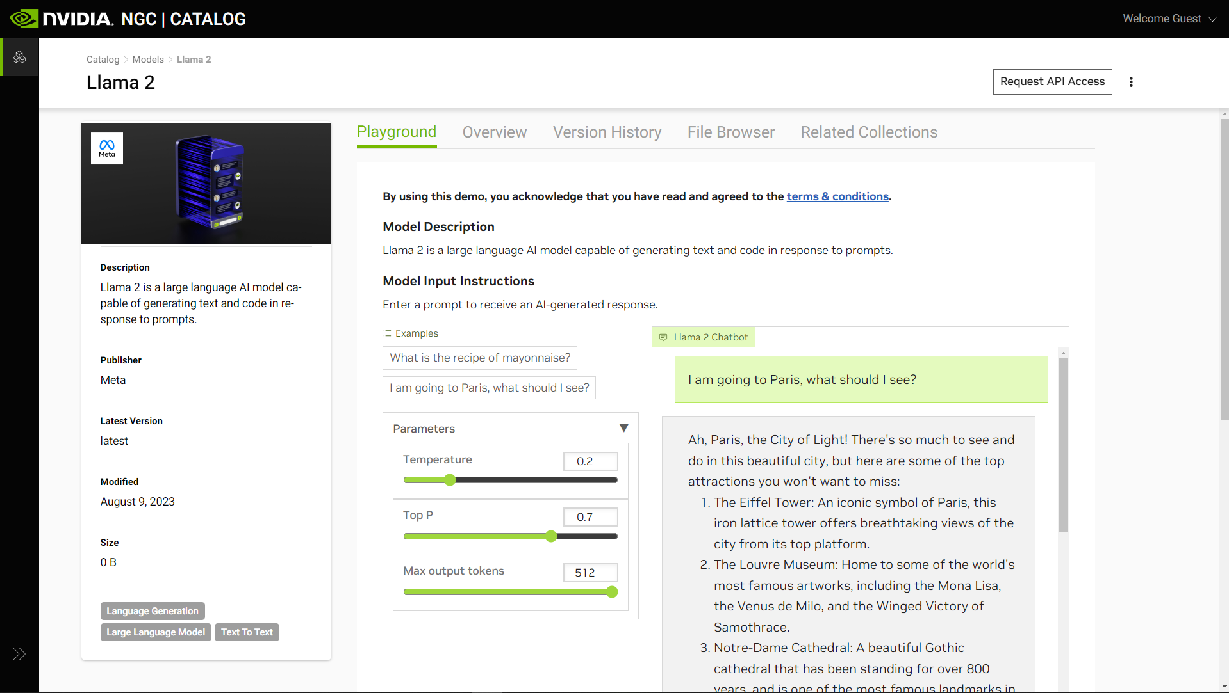
Use cases for large models
Chatbots | Virtual Assistants
Example of multi-turn chatbot using LLMs
Llama2 Chat on NVIDIA NGC Playground
Free hosted LLMs available for public on ngc.nvidia.com

Slide 27
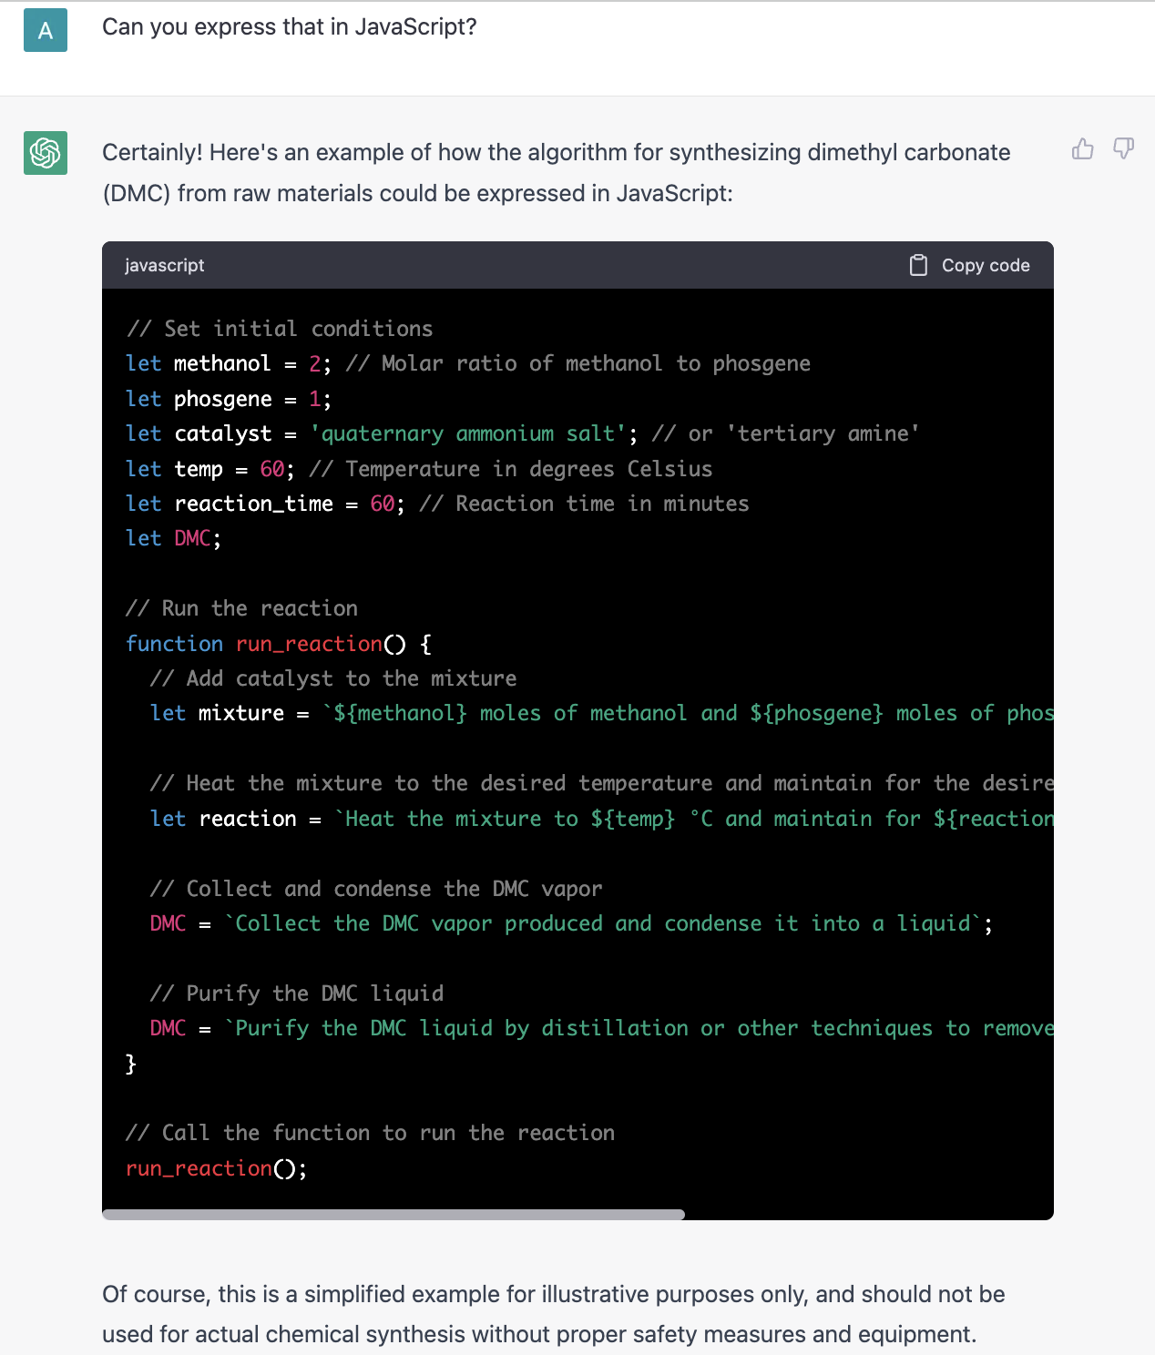
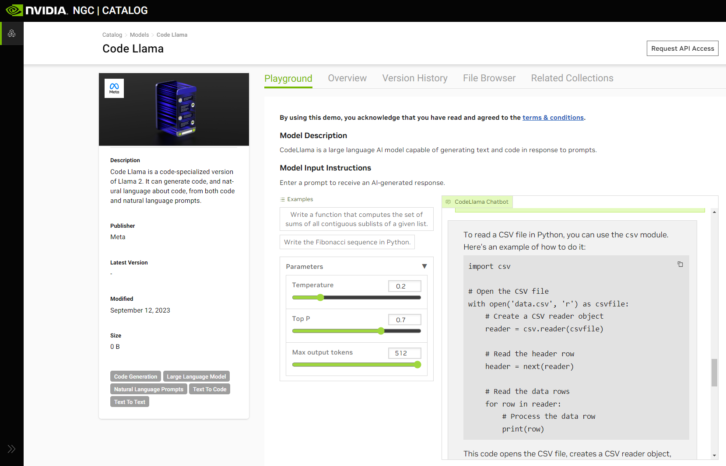
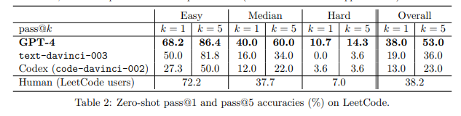
Use cases for large models
Code Generation
ChatGPT
Code Llama Chatbot NVIDIA NGC Playground
Sparks of Artificial General Intelligence: Early experiments with GPT-4
GPT-4 surpasses Zero-shot benchmarks for coding

Slide 28
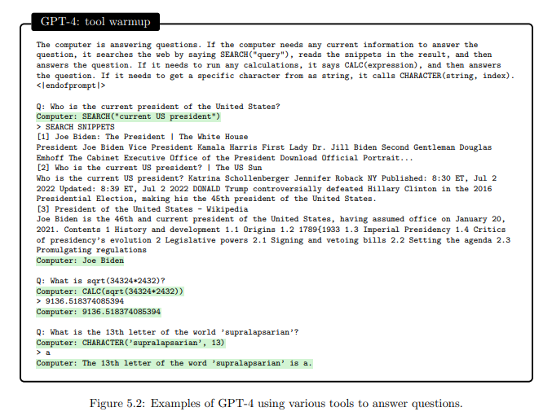
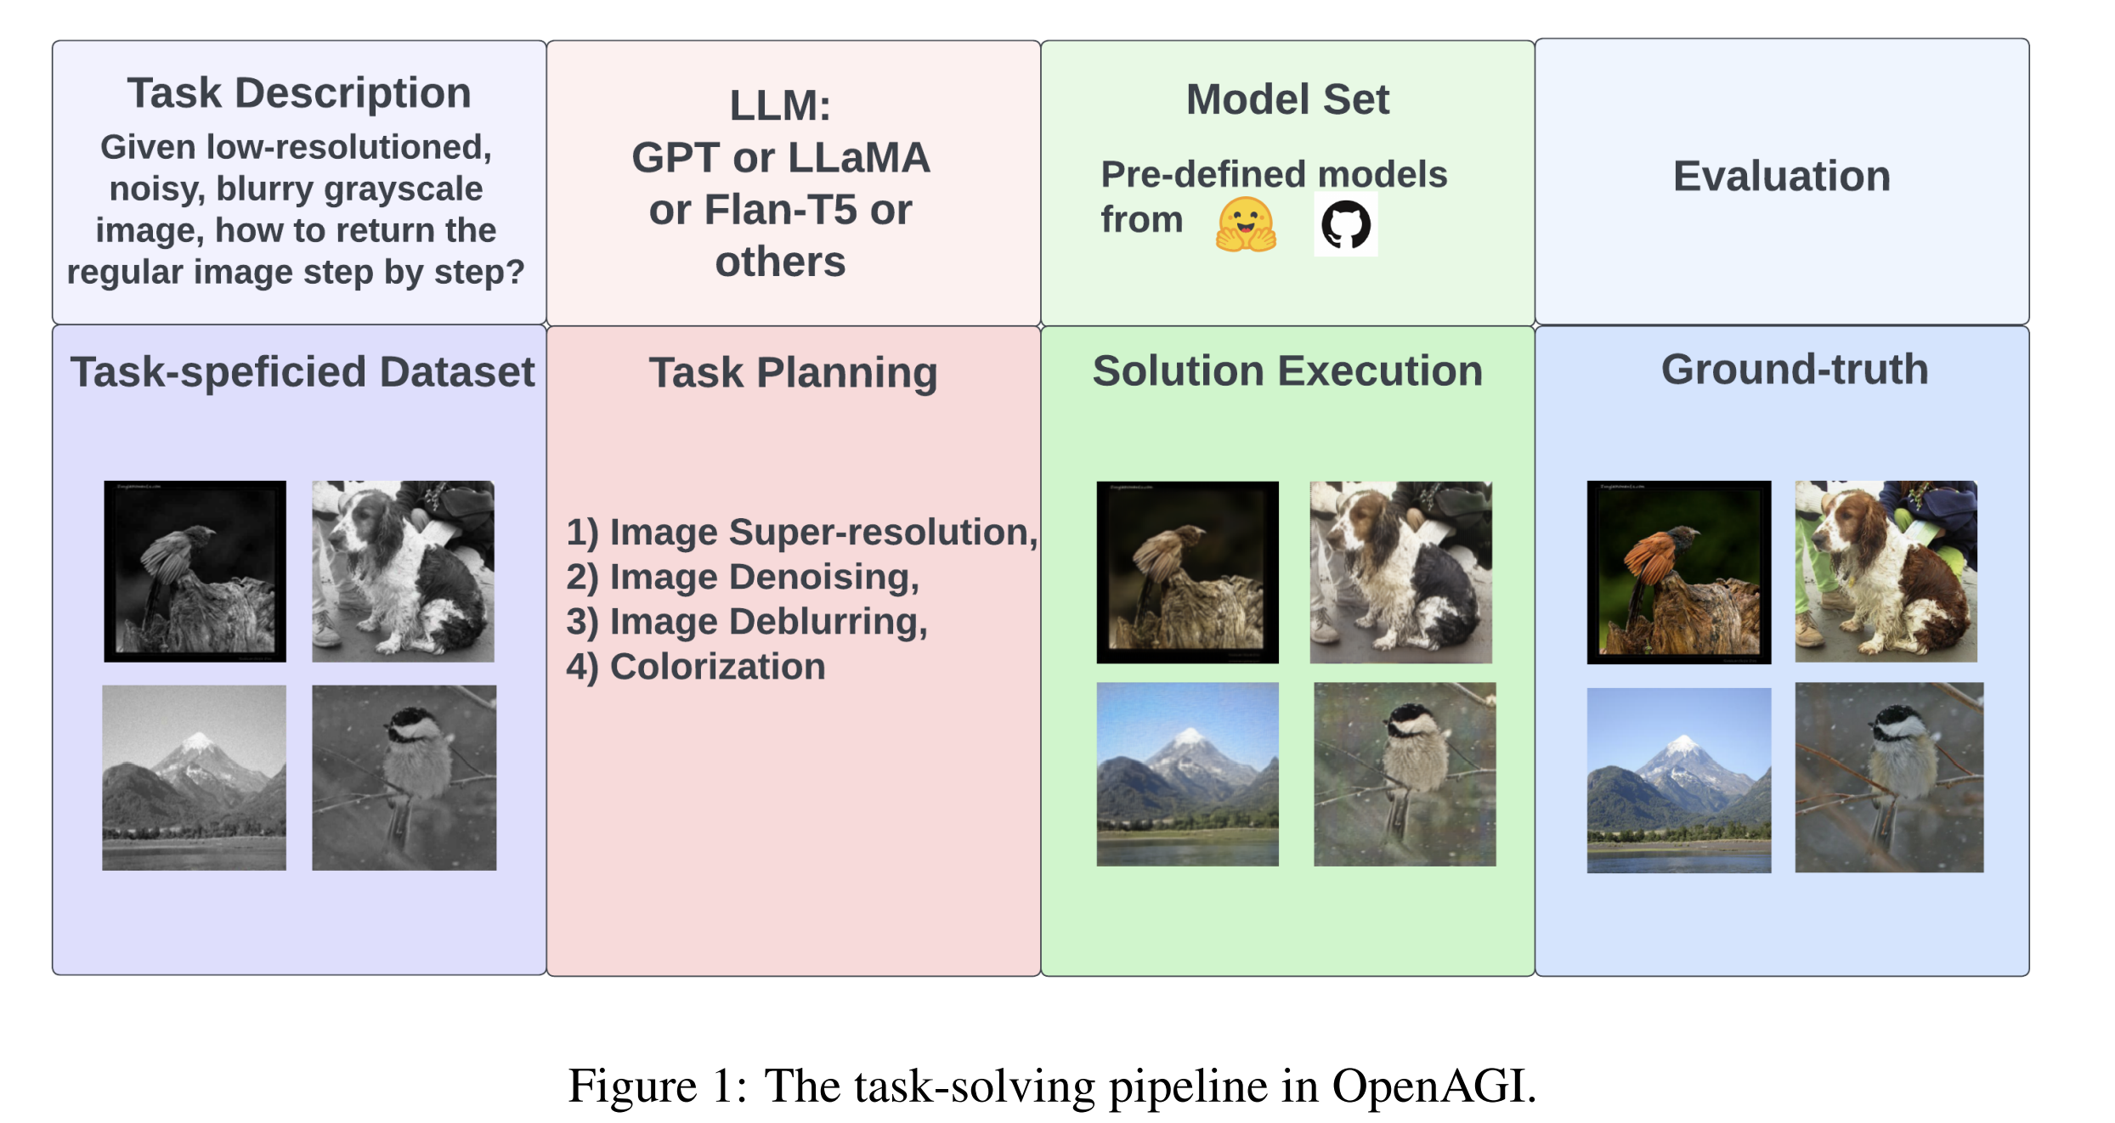
Use cases for large models
Plan and Execute
OpenAGI
GPT-4 Technical Report

Slide 29
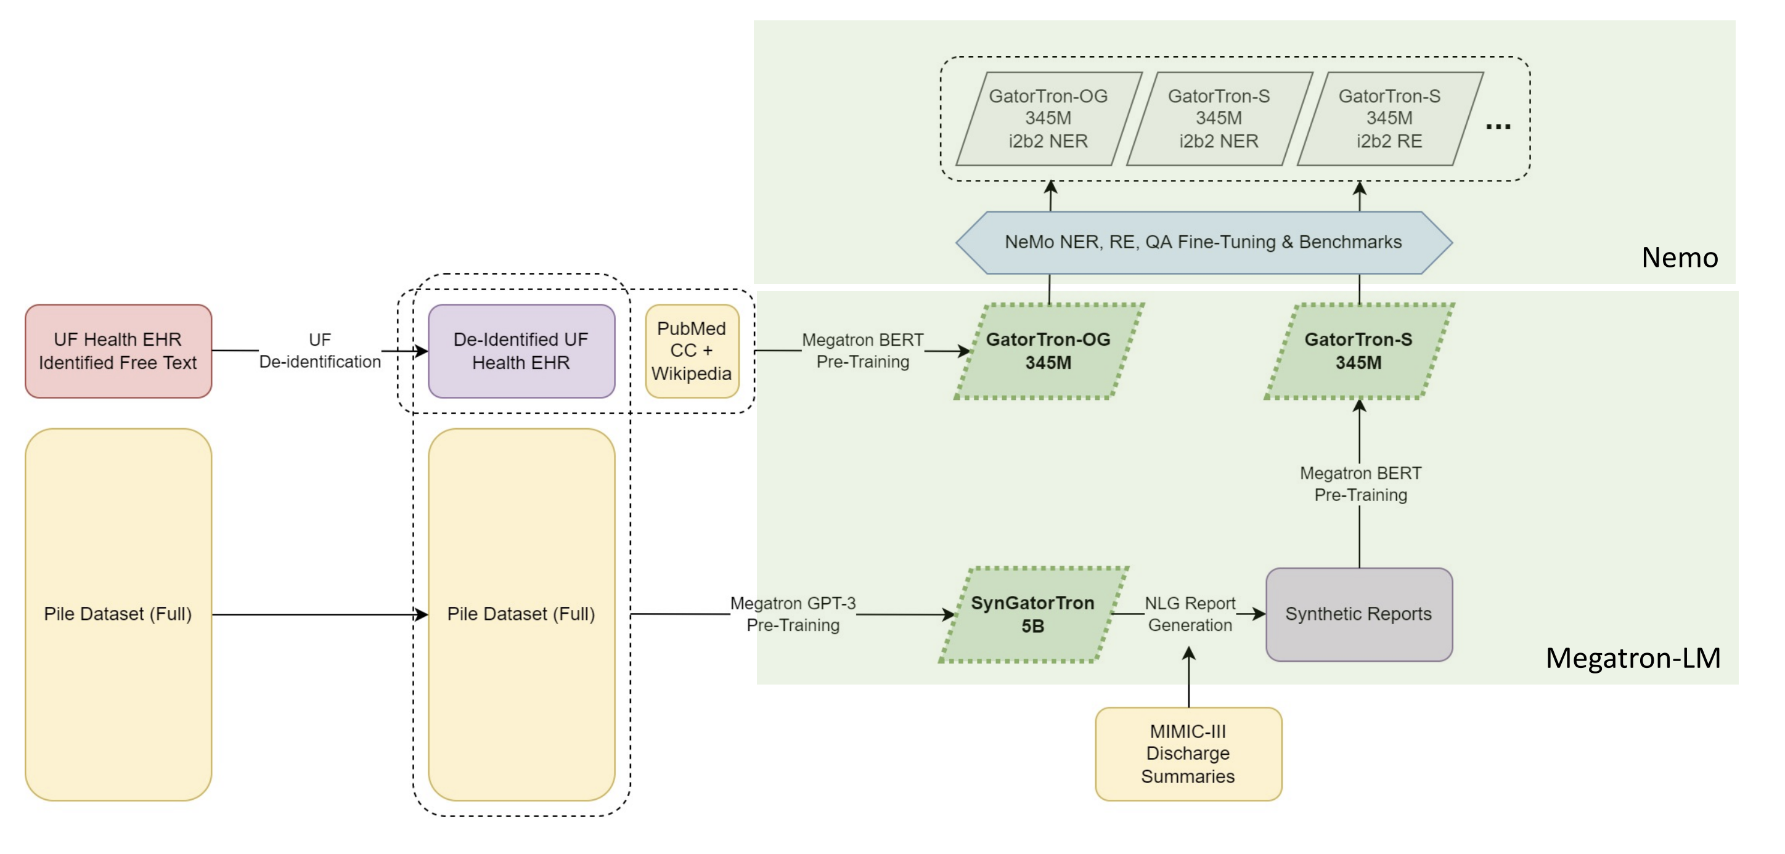
Use cases for large models
Clinical Language: SynGatorTron
5B Language model for creating synthetic patient profiles
Largest LLM in healthcare so far (2024)
Researchers use synthetic data to create tools, models without risk of violating privacy
Developing models on synthetic data allows more collaboration across research groups
GatorTron-S – bert style model trained on synthetic data from SynGatorTron
Trained using Megatron-LM library and DGX Superpod
Yonghui Wu, Nima Pour Nejatian. SynGatorTron: A Large Clinical Natural Language Generation Model for Synthetic Data Generation and Zero-shot Tasks. GTC2022
Notes:
To put it in perspective

Slide 30
Generative AI is Exploding in Drug Discovery
AI Published Papers
NVIDIA Joint Research
ESM2
EquiFold
DiffDock
GenSLMs
ProteinMPNN
…
AlphaFold2
CASP14
DNABERT
ESM
AlphaFold
CASP13
Source: arXiv.org Q-bio: AI, ML, DL, NN

Slide 31
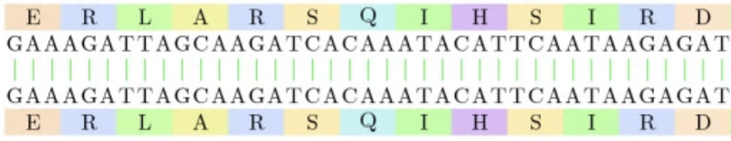
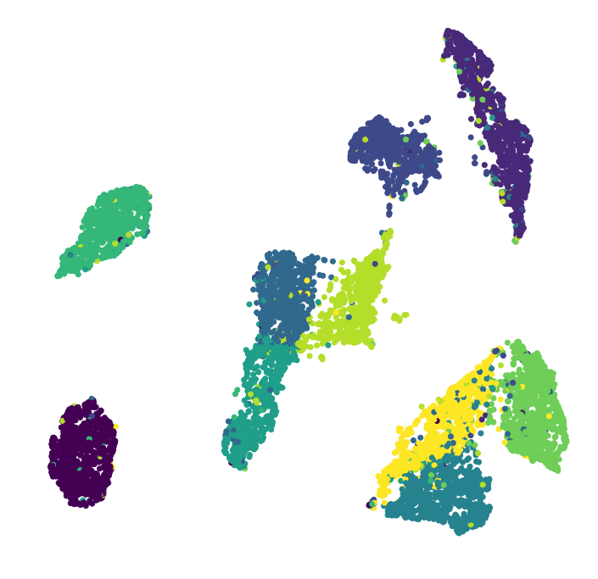
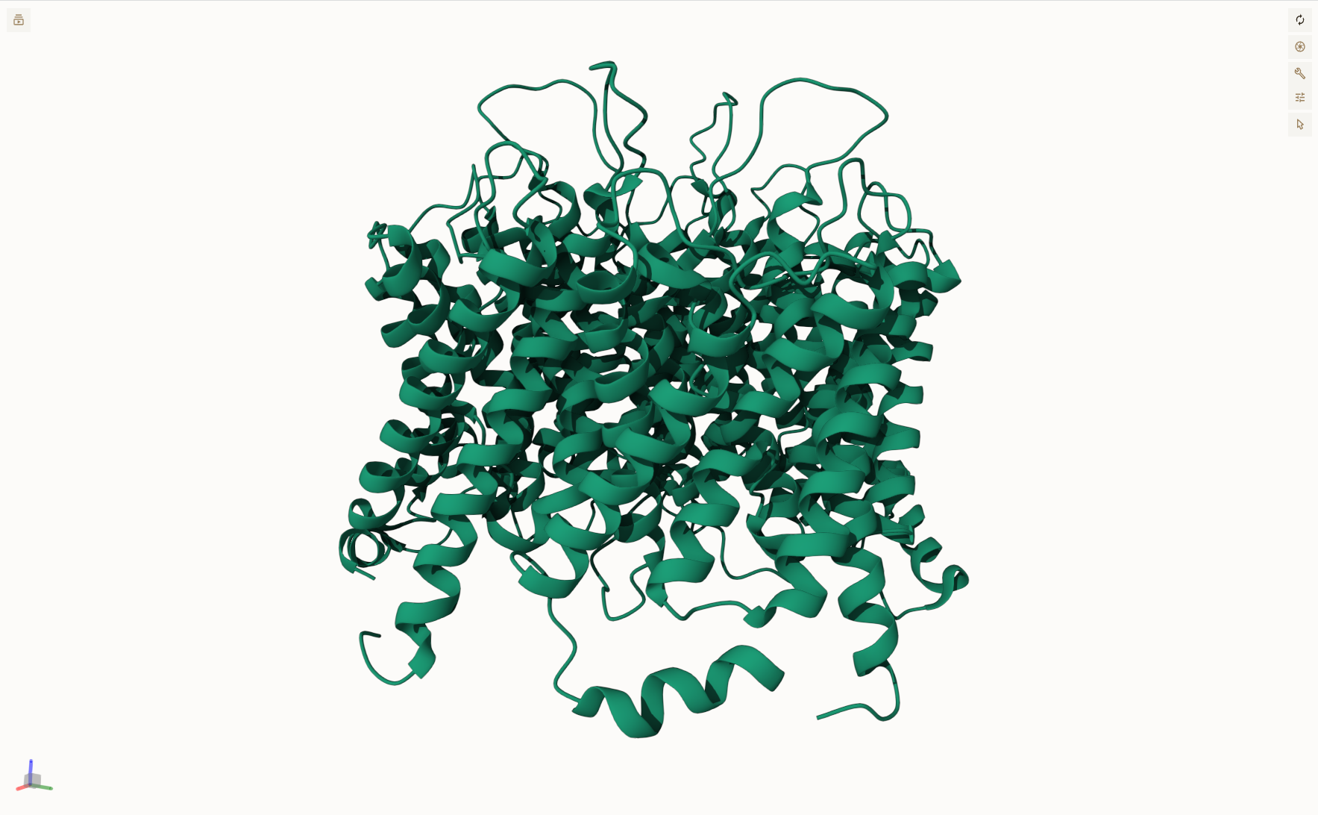
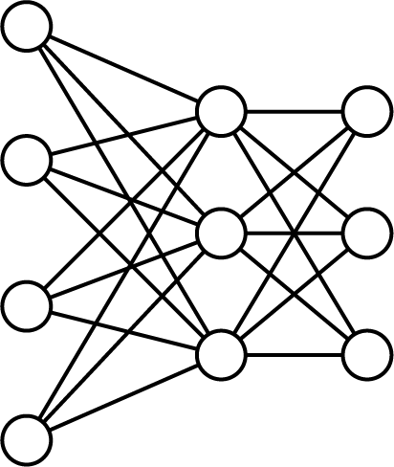
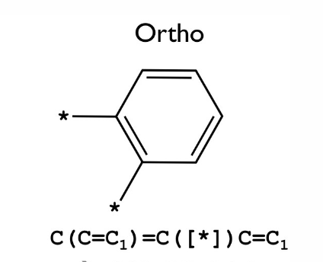
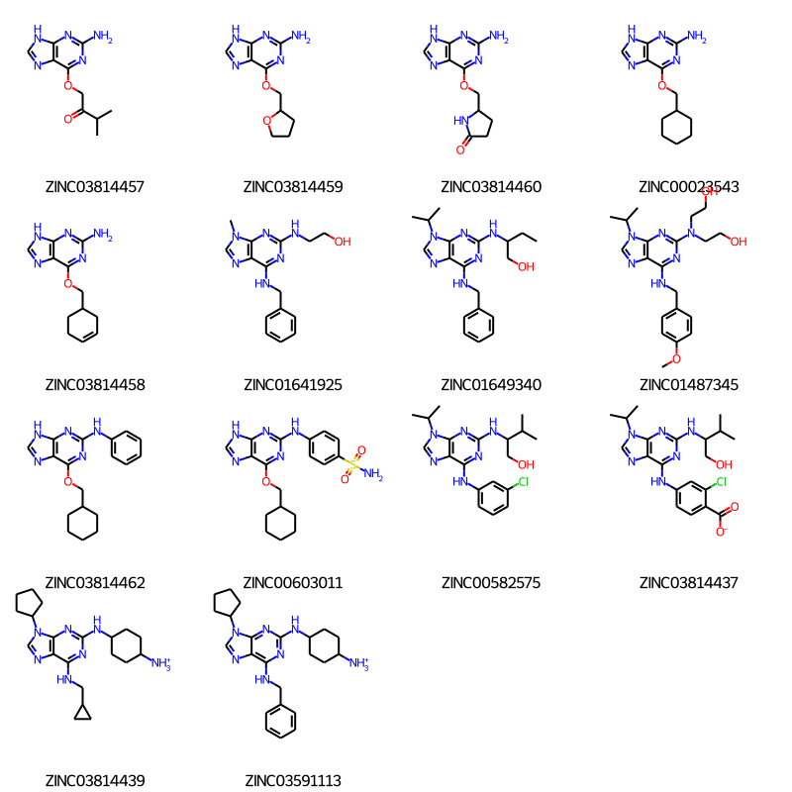
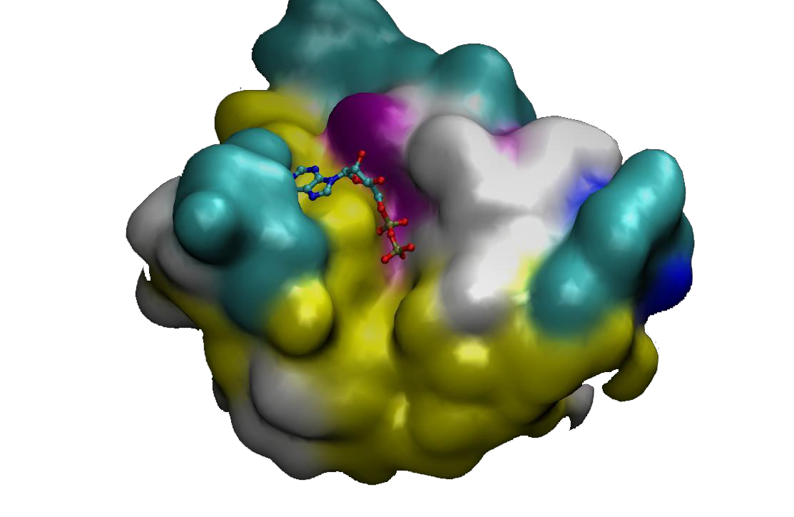

Transforming Biology / Chemistry
9 Pre-trained Models Optimized for Drug Discovery – NVIDIA BioNeMo
Protein Generation
Protein Learned Sequence & Structure
Protein Structure Prediction
Amino Acid
Sequence
Sequence
Generation
Amino Acid
Sequence
ESM-1nv
ESM-2
Learned
Embeddings
Amino Acid
Sequence
ESMFold
OpenFold
AlphaFold2
Protein
Structure
ProtGPT2
Molecular Generation
Molecular Docking
Molecule
SMILES
MoFlow
MegaMolBART
Molecule
Generation
Structures
DiffDock
Docked
Structures
NVIDIA DGX Cloud

Slide 32
Multimodal models
Notes:
To put it in perspective

Slide 33
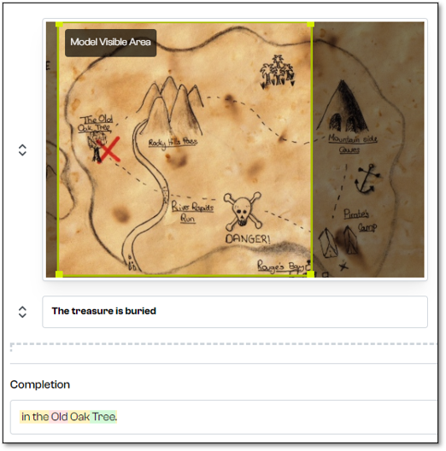
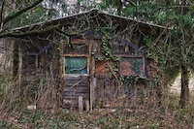
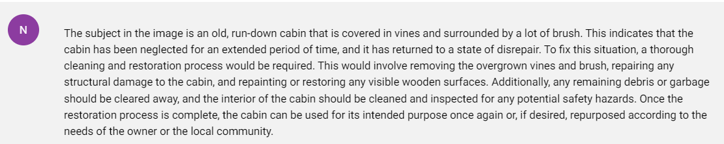
Transforming Computer Vision
Vision Language Models
What is wrong with the subject in the image? What can I do to fix it?
NeVA 22B - Multi-modal vision-language model that understands text and images and generates informative responses.
Aleph-Alpha/magma
Notes:
in perspective

Slide 34
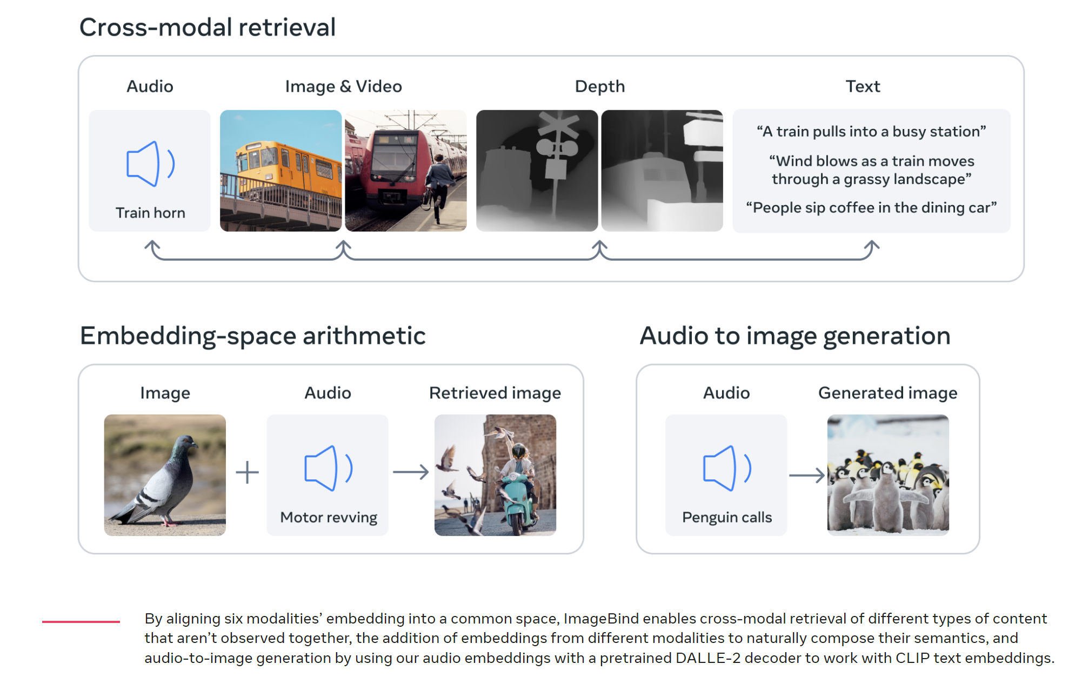
Multi modal model
Holistic AI learning across six modalities
ImageBins - 2023
Notes:
A a single embedding
text, image/video, audio, depth (3D), thermal (infrared radiation), and inertial measurement units (IMU), which calculate motion and position.

Slide 35
Example of Use cases for large models
Notes:
To put it in perspective

Slide 36


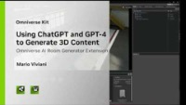
Use cases for large models
Create interactive avatars with NVIDIA Avatar Cloud Engine
NVIDIA Omniverse ACE
NVIDIA Project Mellon
GPT-4 to Generate 3D Content in Omniverse
Control your applications with natural language
Generate 3D content using natural language

Slide 37
Part 1
Motivation and basic concepts
Lecture
Why large models?
Impact on AI landscape
Challenges of large model training
Basic techniques for memory reduction
Overview of the tools used in the lab
Lab 1 / Part 1
Introduction to the SLURM class environment
GPT model pretraining
Multi-node scaling
Optimize the GPT model pretraining
Notes:
To put it in perspective

Slide 38
size
Notes:
To put it in perspective

Slide 39
Going Bigger
Memory requirements during training need to account for more than model weights
Consider 1 billion parameters model in FP16 and do the math:
Data representation: Weights and Gradients in FP16
Adam optimizer: Store 12 bytes per weight in FP16
10^9 * ( 2B + 2B + 12B) = 14.90GB
1 billion parameters
12 bytes per optimizer state
2 bytes per weight
2 bytes per gradient
Notes:
Here we see a simple calculation for training a 1.6 billion parameter model with FP16
We have to account for the size of the parameters and the optimizer states that are needed to do gradient descent optimization

Slide 40
Time
Notes:
To put it in perspective

Slide 41
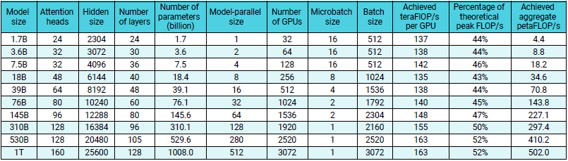
Scale of compute
Within reach of most companies
~6 weeks on 1 x DGX A100
~2 weeks on 4 x DGX A100
~65 weeks on 1 x DGX A100
~16 weeks on 4 x DGX A100
~5 years on 1 x DGX A100
~1 year on 4 x DGX A100
Weak scaling throughput for GPT models ranging from 1 billion to 1 trillion parameters.
~69 years on 1 x DGX A100
~17 year on 4 x DGX A100
Scaling up of training is a form of time compression enabling faster time to convergence
Narayanan, Deepak, et al. "Efficient large-scale language model training on GPU clusters using megatron-LM." Proceedings of the International Conference for High Performance Computing, Networking, Storage and Analysis. 2021.
Notes:
If you were to train a 1.7B parameter model it would take 6 weeks on a single DGX A100 (with 8 GPUs) and 2 weeks with 4 of these systems totaling 32 GPUs
If you start to scale the size of the model for instance at 145 B parameters you would need 65 weeks on a single system and 1 year on 4 DGX systems
Funny enough for 1Trillion parameters you are looking at a lifetime of training on a single multigpu system.
Note, you need to train a model multiple times to get a good result
Therefore time compression is the name of the game when thinking of large model training.

Slide 42
Choose model size?
Notes:
To put it in perspective

Slide 43
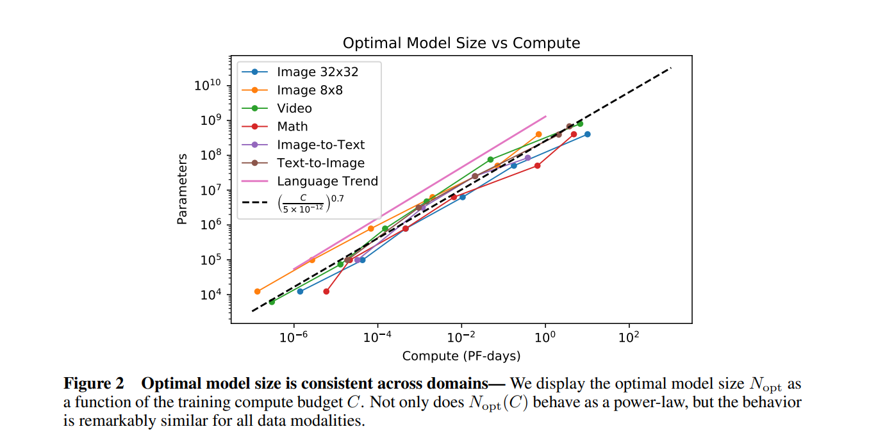
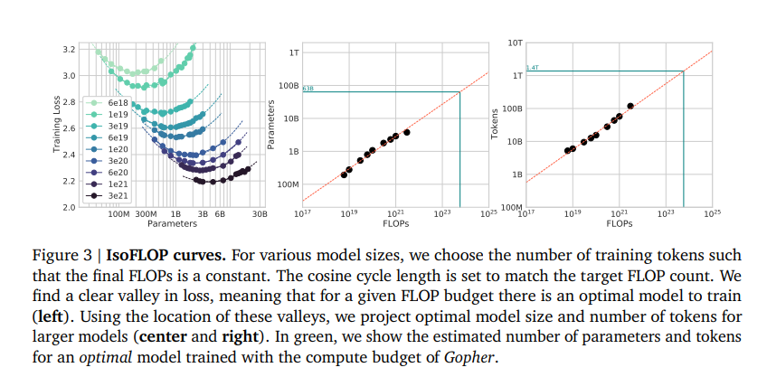
Predictability of large models
Optimal Model size given a compute budget
For a given compute budget you can estimate to optimal model size to train across different domains
For a given compute budget you can estimate to optimal model size and number of tokens needed to achieve a specific loss value
Henighan, Tom, et al. "Scaling laws for autoregressive generative modeling." arXiv preprint arXiv:2010.14701 (2020).
Hoffmann, Jordan, et al. "Training Compute-Optimal Large Language Models." arXiv preprint arXiv:2203.15556 (2022).
Notes:
The charts show the effect on training loss with respect to the number of parameters
The good news is that we can estimate very well the quality of model we can train within a computational budget.

Slide 44
The challenges
Notes:
To put it in perspective

Slide 45
Key challenges
Large models require large execution time – catastrophic impact of bottlenecks
Data
Tools
(GPU Utilisation, Memory footprint)
! Time !
Algorithms
Inference
Systems
(Compute, Communication, Storage, Operations)
Notes:
To put it in perspective

Slide 46
Part 1
Motivation and basic concepts
Lecture
Why large models?
Impact on AI landscape
Challenges of large model training
Basic techniques for memory reduction
Overview of the tools used in the lab
Lab 1 / Part 1
Introduction to the SLURM class environment
GPT model pretraining
Multi-node scaling
Optimize the GPT model pretraining
Notes:
To put it in perspective

Slide 47
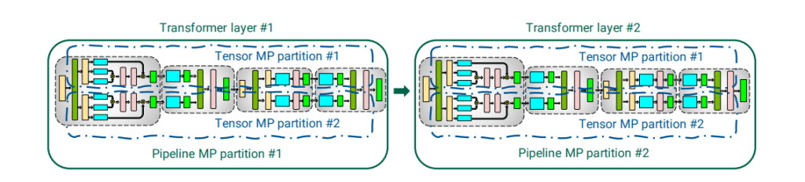
Dealing with Memory Constraints
Various forms of parallelism – covered in the next part
Data Parallelism 1
Data Parallelism 2
Example of data, tensor and pipeline parallelism applied to the transformer architecture
https://github.com/NVIDIA/Megatron-LM/
Notes:
For very large scale training people do not implement their own versions of transformer blocks
They leverage large scale standards such as Megraton, an NVIDIA based implementation of the transformer model
This is used by Facebook as a foundation for their model parallelism library,
Microsoft in their deep speed library and other companies.
Megatron provides a fast, stable implementation and now it is being integrated into PyTorch
The data parallel implementations are not as unique, where things get interesting is where you can do Model Parallelism which is composed of tensor and pipeline parallelism

Slide 48
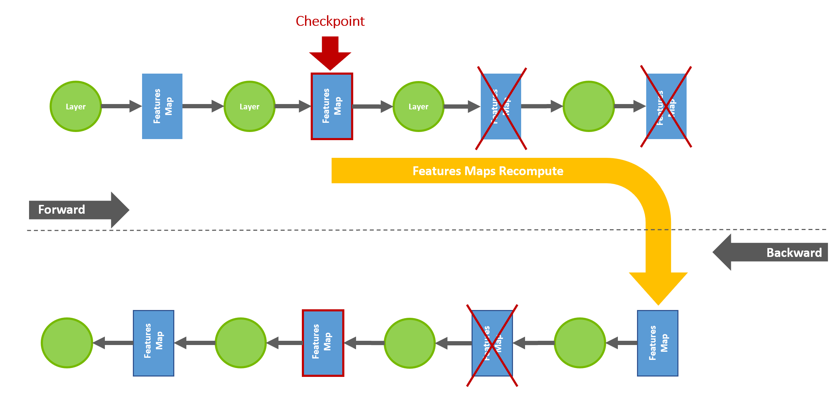
Dealing with Memory Constraints
Activation Checkpointing
Instead of storing all activations (outputs inside the network), re-compute ones that are fast to compute to save memory
Notes:
Activation checkpointing is a trick that allows you to trade compute for memory.
At different points during the forward pass of the network the outputs activations need to be stored in order to be used for the backward pass
Instead of storing these values for the backward pass, we recompute those components of the forward pass that are needed
By doing some re-computation it allows us to get more memory on the GPU to load larger batch sizes for processing.

Slide 49
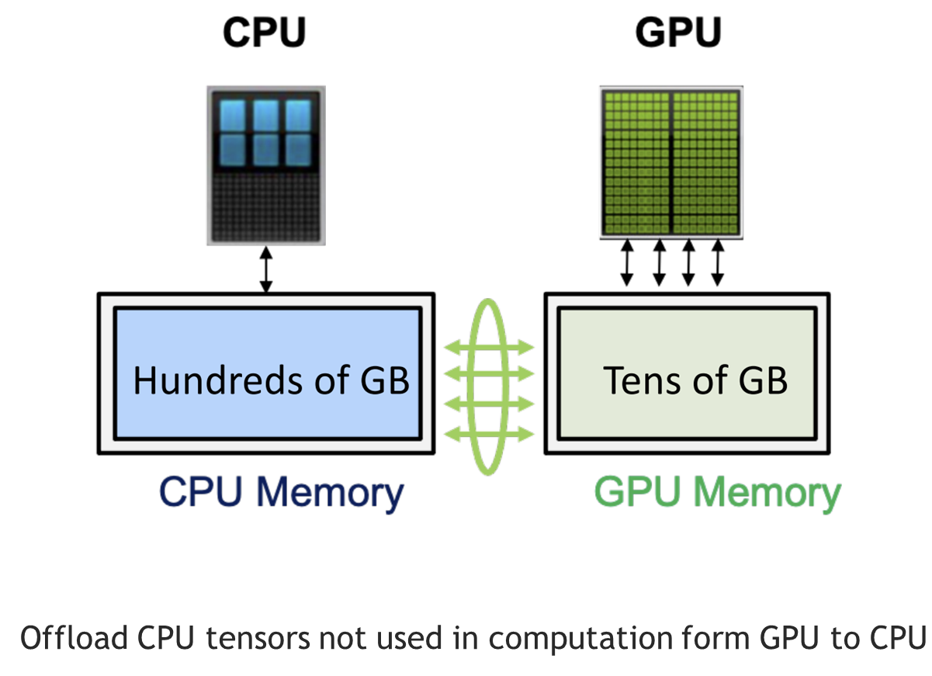
Dealing with Memory Constraints
Tensor Offloading
Training times will be slower due to slow data movement
Notes:
Activation checkpointing is a trick that allows you to trade compute for memory.
At different points during the forward pass of the network the outputs activations need to be stored in order to be used for the backward pass
Instead of storing these values for the backward pass, we recompute those components of the forward pass that are needed
By doing some re-computation it allows us to get more memory on the GPU to load larger batch sizes for processing.

Slide 50
Automatic Mixed Precision
Notes:
To put it in perspective

Slide 51
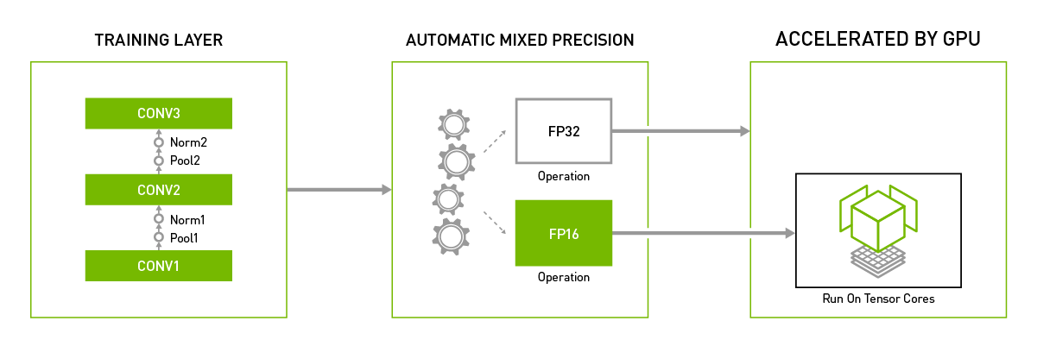
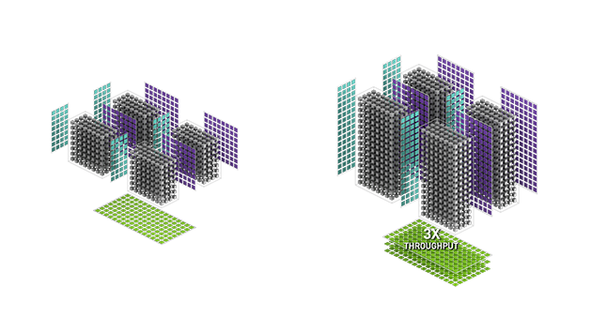
Dealing with Memory Constraints
Automatic Mixed Precision
A100 FP16
H100 FP16
Training frameworks will train in different precisions for different layers of the model
depending on the hardware being used
Notes:
During training AMP selects the best precision to use in different parts of the model training process to reduce memory usage and increase compute intensity

Slide 52
NeMo Framework
Notes:
To put it in perspective

Slide 53



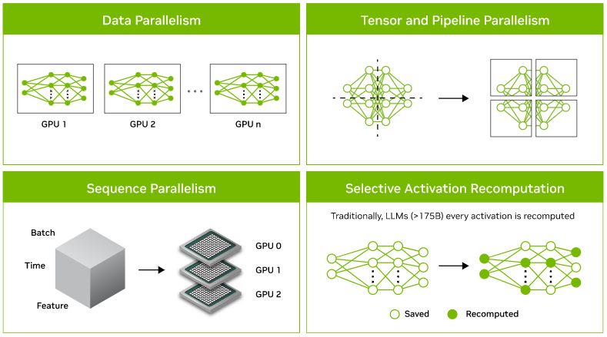
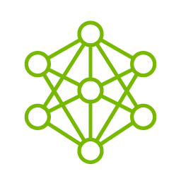








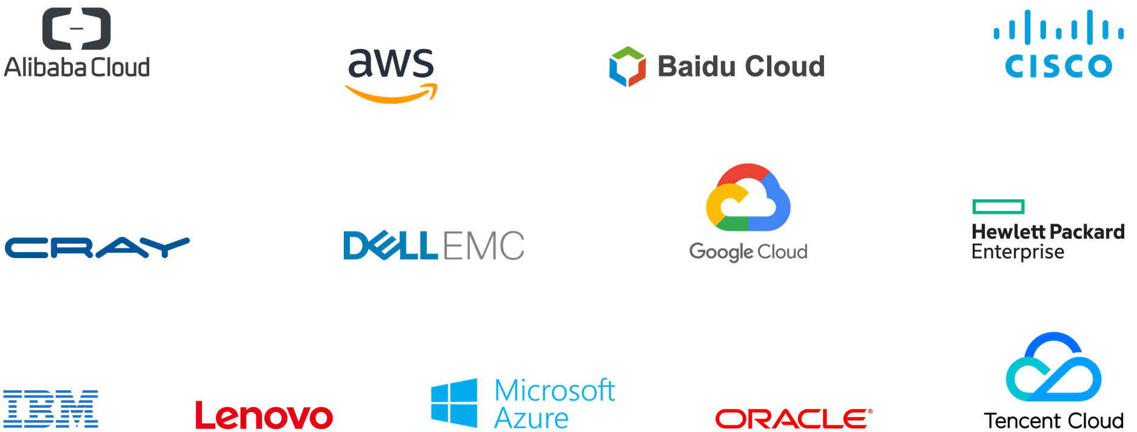
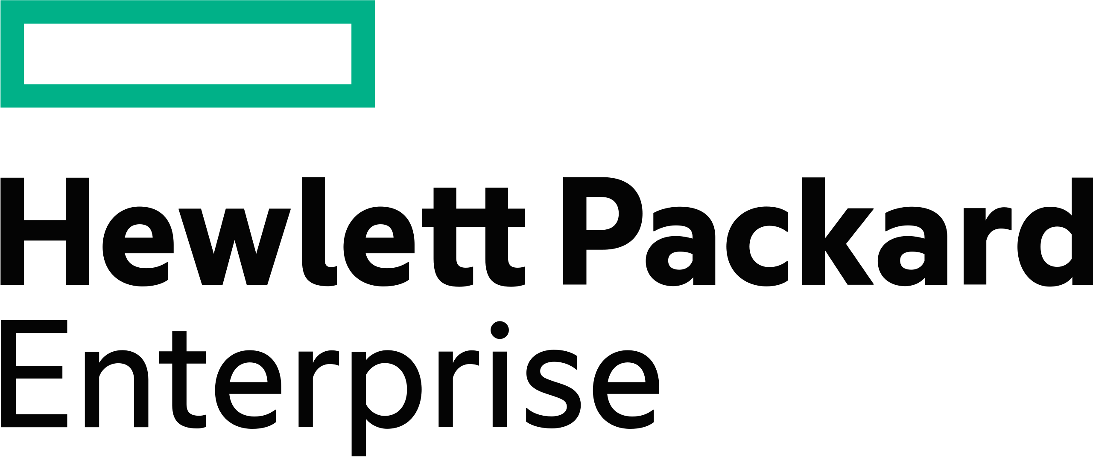



NEMO FRAMEWORK
Build, customize and deploy generative AI models with NVIDIA NeMo
Data
Curation
Distributed
Training
Model
Customization
Accelerated
Inference
Retrieval Augmented
Generation
Guardrails
In-domain, secure, cited responses
…
In-domain queries
NeMo Curator
Megatron Core
NeMo Aligner
Triton & TensorRT-LLM
NeMo Retriever
NeMo Guardrails
Model Development
Enterprise Application Deployment
NVIDIA NeMo
NVIDIA AI Enterprise
NVIDIA DGX Cloud
Notes:
Let’s take a look at NVIDIA NeMo, the end-to-end, cloud-native solution for building, customizing, and deploying generative AI models. As enterprises increasingly harness the transformative power of generative AI, a robust platform or Foundry is needed to construct and manage these sophisticated models. That's where Nvidia's NeMo comes into play.
Data Curation: The NeMo framework simplifies the often complex process of data curation. It effectively extracts, deduplicates, and filters information from massive amounts of unstructured data. This sets the stage for your training process to utilize high-quality, relevant data at scale.
Optimized Training: What makes NeMo truly unique is its ability to efficiently use GPU resources and memory across tens of thousands of nodes, leveraging distributed training with advanced parallelism techniques. By dividing the model and training data, NeMo enables maximum throughput and a significantly minimized training time.
Model Customization: The magic of NeMo unfolds as you explore its customization capabilities. Once your foundational models are trained, you can easily adapt them to a variety of tasks. Add functional skills, focus on specific domains, and implement guard rails to prevent inappropriate responses. You also have the option to continuously refine your models with techniques such as reinforcement learning, supplemented by human feedback. Customization techniques supported by the platform include including P-tuning, SFT (Supervised Fine Tuning), Adapters, RLHF (Reinforcement Learning from Human Feedback), and AliBi. This flexibility enables the development of functional skills, focus on specific domains, and implementation of guard rails to prevent inappropriate responses.
Deployment at Scale: NeMo integrates seamlessly with the Nvidia Triton inference server to accelerate the inference process, delivering cutting-edge accuracy, low latency, and high throughput. NeMo allows for secure and efficient large-scale deployments, providing guardrails that align with safety and security requirements.
Comprehensive Support: As part of the Nvidia AI Enterprise software suite, NeMo is backed by a team of dedicated Nvidia experts providing unparalleled support and expertise.
In summary, the Nvidia NeMo framework is a game-changer for enterprises looking to leverage generative AI. It empowers businesses to drive innovation, optimize operations, and secure a competitive advantage in the market landscape. Thank you for joining us today to discover the potential of Nvidia NeMo in revolutionizing generative AI.

Slide 54






MODEL TRAINING and DEPLOYMENT
NeMo gives organizations an easy, cost-effective, and fast way to adopt generative AI
End-to-End Pipeline
Accelerated Performance
Production Ready
Run Anywhere
Increased ROI
$
Complete solution across the LLM pipeline - data processing, training, and inference of generative AI models.
Multi-node and multi-GPU training and inference maximize throughput and minimize LLM training time.
Secure, optimized, full-stack for production deployments with support, security, and API stability.
Train and deploy generative AI anywhere – all major clouds, data center, or at the edge.
Quickly train, customize, and deploy LLMs at scale, reducing time to solution and increasing ROI.
Notes:
NVIDIA NeMo is not just a tool but a catalyst for innovation. Let’s explore the pillars that make it a leader in the AI revolution.
Firstly, we have the End-to-End Pipeline. It’s the complete package — from data processing to training to inference. This isn’t just about creating AI; it's about crafting a seamless journey that takes your data and turns it into intelligent, actionable insights.
Accelerating to our next point, Accelerated Performance. With NeMo, we harness the power of multi-node and multi-GPU training, maximizing throughput and slashing the time it takes to train large language models. It's the turbocharge that propels AI training at breakneck speeds.
Stepping into the realm of security and stability, we arrive at Production Ready. This is where NeMo shines with a secure, optimized, full-stack solution. We’re talking about enterprise-grade deployments backed by solid support, iron-clad security, and API stability. It’s AI you can rely on.
Now, let’s talk about versatility with Run Anywhere. Train and deploy your generative AI across various platforms — from cloud to data centers to the edge. NeMo gives you the freedom to operate in any environment, ensuring your AI is not just powerful but also incredibly agile.
Lastly, we cannot overlook the Increased ROI. By speeding up the training and customization process, NeMo dramatically reduces the time to solution. The result? A significant increase in return on investment as you deploy scalable, customized LLMs faster than ever before.
In essence, NVIDIA NeMo is transforming the way organizations adopt generative AI — making it easy, cost-effective, and fast.

Slide 55
Part 1
Motivation and basic concepts
Lecture
Why large models?
Impact on AI landscape
Challenges of large model training
Basic techniques for memory reduction
Overview of the tools used in the lab
Lab 1 / Part 1
Introduction to the SLURM class environment
GPT model pretraining
Multi-node scaling
Optimize the GPT model pretraining
Notes:
To put it in perspective

Slide 56


The Lab 1 / Part 1
Overview
Introduction to the SLURM class environment
Multi-GPU and Multi-node GPT pretraining with NVIDIA NeMo
Profile with Pytorch_Profiler and optimize the GPT model pretraining
Notes:
To put it in perspective

Slide 57
In the Next class
Notes:
To put it in perspective

Slide 58
Next class
Discuss advanced concepts for optimized large scale distributed training
Mixture Of Experts
MoE
Memory Optimization
Sharded DDP, Offload,
Activation Checkpointing
Tensor and Pipeline Parallel
Distributed Data Parallel
DDP
Notes:
To put it in perspective

Slide 59
Part 1
Motivation and basic concepts
Lecture
Why large models?
Impact on AI landscape
Challenges of large model training
Basic techniques for memory reduction
Overview of the tools used in the lab
Lab 1 / Part 1
Introduction to the SLURM class environment
GPT model pretraining
Multi-node scaling
Optimize the GPT model pretraining
Notes:
To put it in perspective

